Slide 1
Summary of SmartD project
Xiaotao Shen
October 10th, 2019

Slide 2
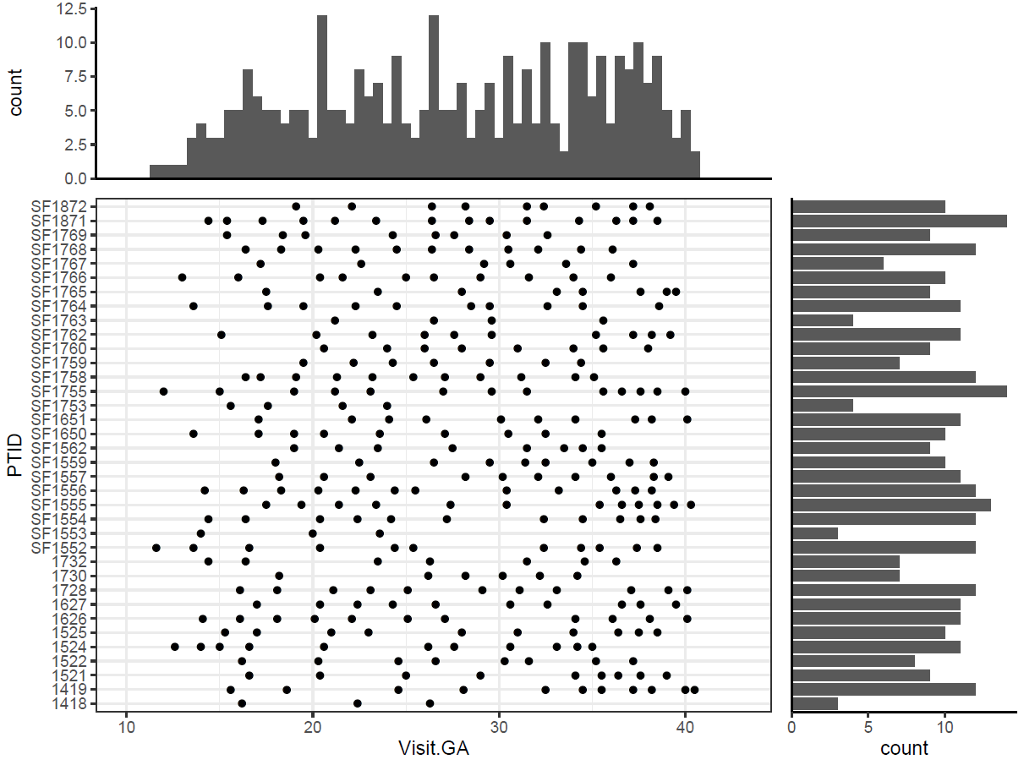
Patient information (sample collection)
36 patients 346 urine samples.
Notes:
Birth GA – sample GA
Birth GA < 39
Birth GA > 39

Slide 3

Data sets and processing
RPLC
Raw data
Peak detection
Batch 1
Positive mode: 145 samples × 5,242 peaks
Negative mode: 145 samples × 4,261 peaks
Batch 2
Positive mode: 185 samples x 4,074 peaks
Negative mode: 185 samples x 4,183 peaks
RT correction
Noisy peak removal
Outlier sample removal
MV imputation
Data normalization
Peak table

Slide 4
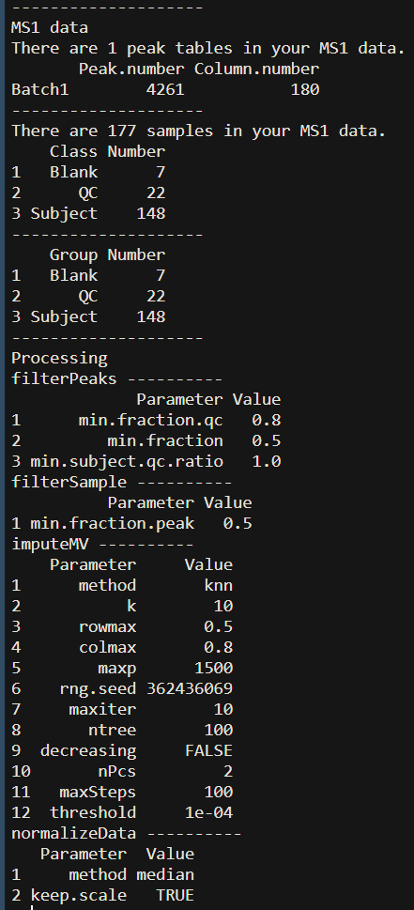
metflow2: A integrated metabolomics data analysis pipeline
RPLC
Raw data
Peak detection
RT correction
Noisy peak removal
Outlier sample removal
MV imputation
Data normalization
Peak table

Slide 5

Data sets and processing
Peak table
In-house library match (Level 1)
Public library match (Level 2)
520 metabolites
HMDB accurate mass library match (Level 3)
Annotation redundancy removal
Metabolite table (matrix)

Slide 6
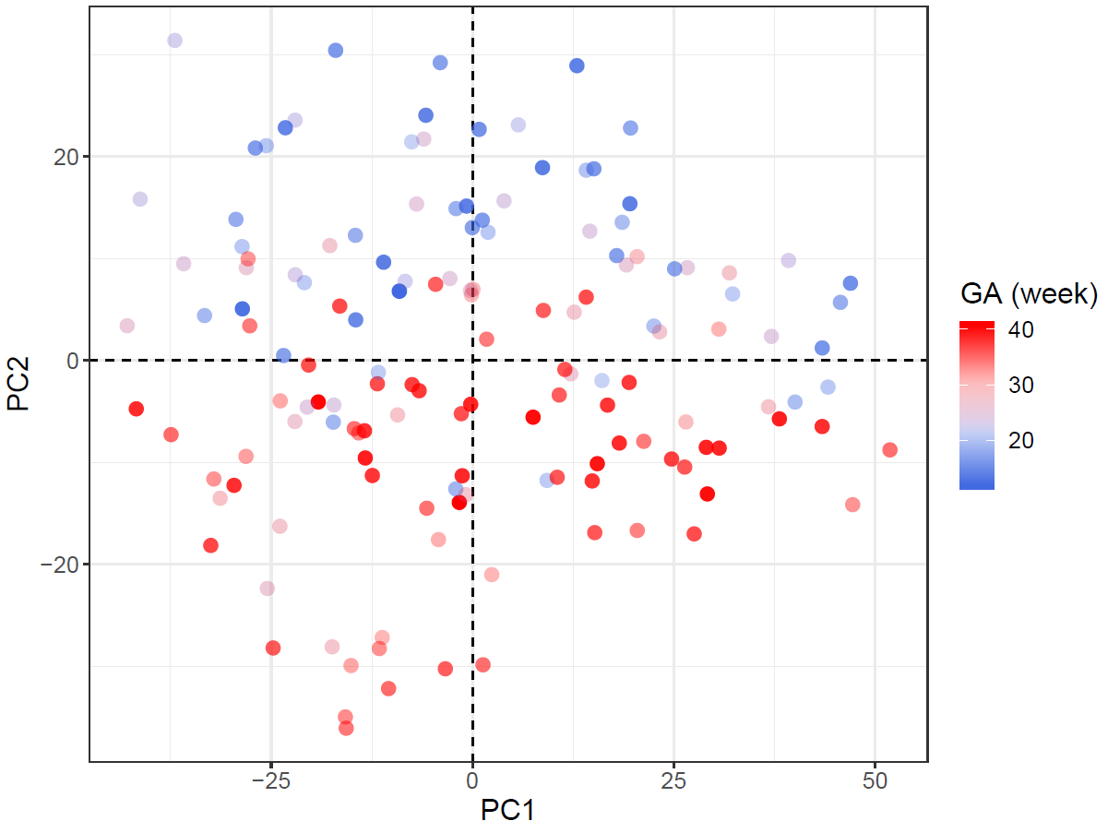
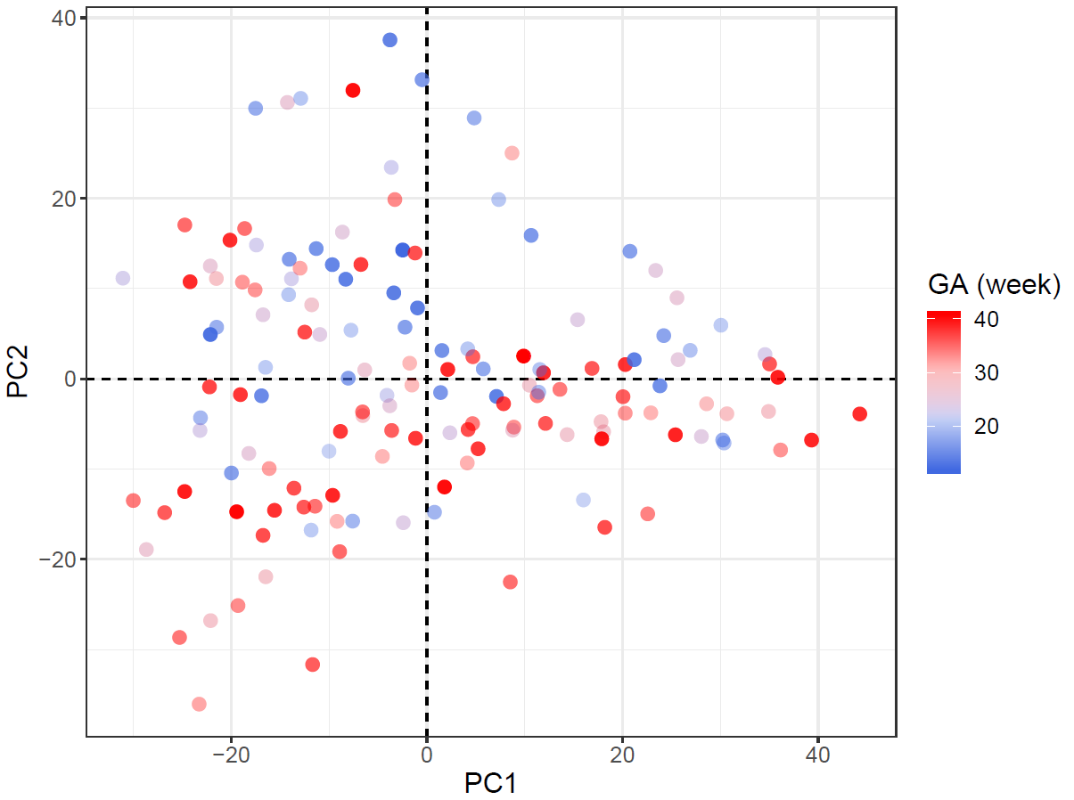
Overall metabolic profile
Unsupervised method (PCA) Batch 1
Positive mode
Negative mode

Slide 7
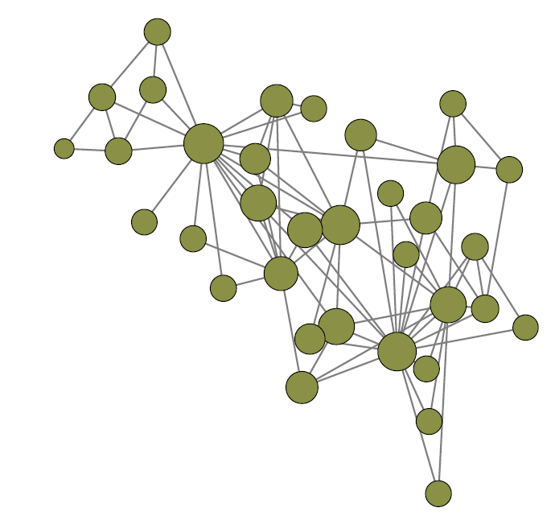
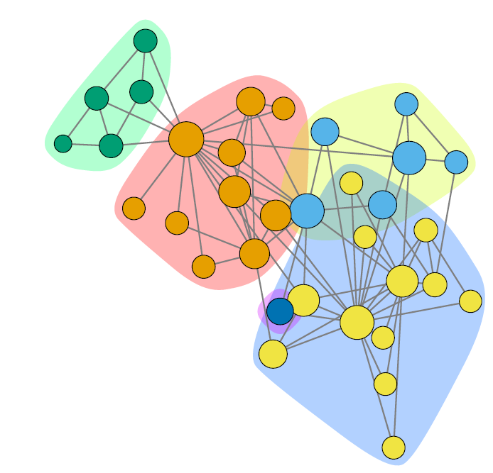
Community analysis
0.4
0.3
Modularity
0.2
0.1
0.0
0
10
20
30
Community analysis iteration
Q: Modularity
m: Total number of edges
A_{ij}: i and j are two nodes in the graph. If i and j are directly connected, A_{ij} = 1, or A_{ij} = 0.
k_{i}/k_{j}: The degree of node i/j.
δ(c_{i},c_{j}): If node i and j are in one subgraph, it equals to 1, or 0.

Slide 8
Two correlation network
Cross-sectional correlation network
Cross-sectional correlations were calculated from mean measurements of metabolites calculated using all time points (mean A is correlated with mean B across all individuals).
Delta correlation network
Delta correlations were calculated on the change in analytes between time points (the change in A between time points is correlated with the change in B across all individuals).
The communities often represented a cluster of physiologically related metabolites.

Slide 9
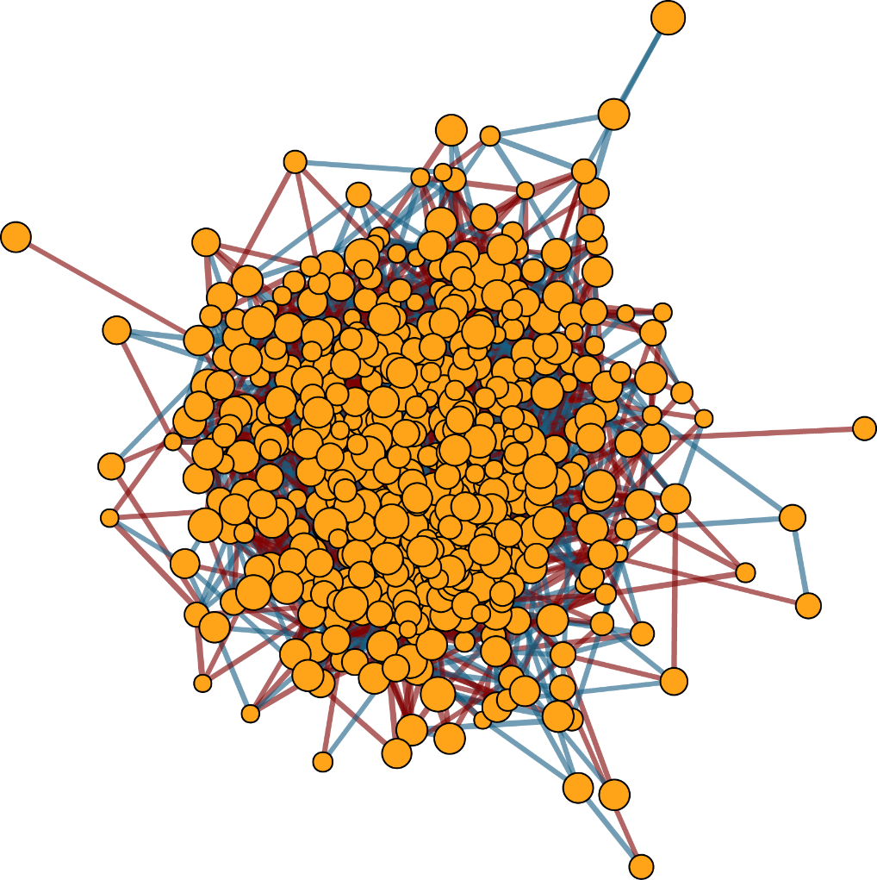
Whole cross-sectional correction network
520 vertexes (metabolites)
4,532 edges
Spearman correlation:
Correlation > 0.5 or Correlation < -0.5
P_{adjust} < 0.05

Slide 10
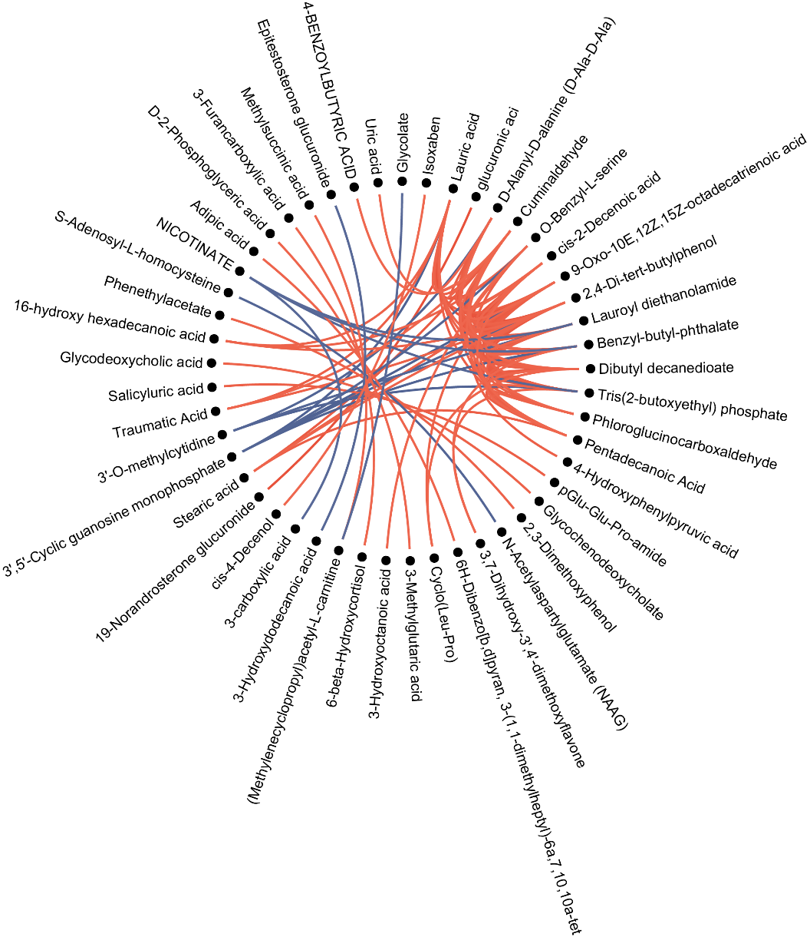
Top 100 correlations of cross-sectional correction network
Subset of top statistically significant Spearman cross-sectional correlations between all data sets collected in our cohort. Each line represents one correlation that was significant after adjustment for multiple hypothesis testing using the method of Benjamini and Hochberg10 at P_{adj} < 0.05.

Slide 11
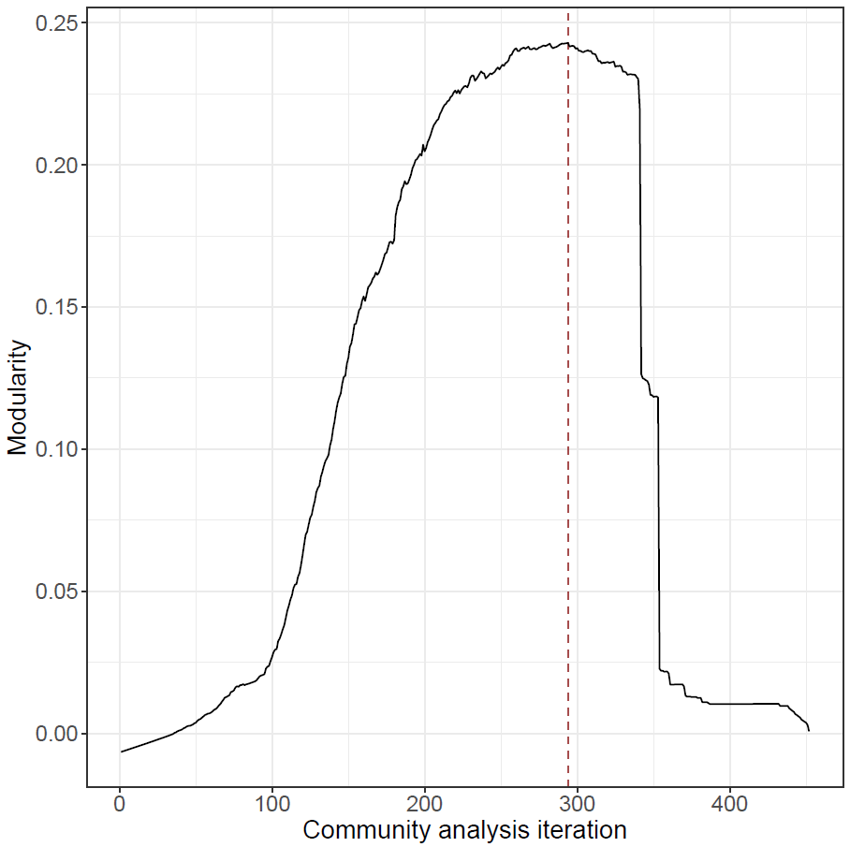
Subnetwork detection using community analysis
Modularity is 0.25 at 365 iteration
50 subnetworks with at least two vertexes (mean of 7.52 V and 48.6 E).
376 out of 520 vertexes (72.3%) are remained after community edge punching.
2430 out of 4532 edges (53.6%) are remained after community edge punching.

Slide 12
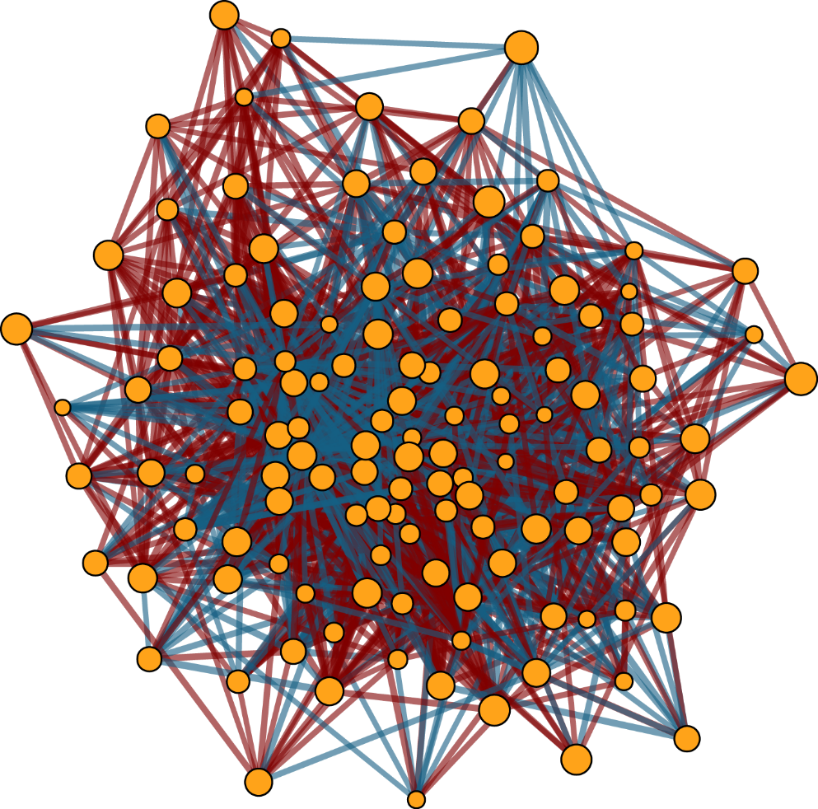
Cross-sectional subnetwork 5
125 vertexes (metabolites)
2,022 edges

Slide 13
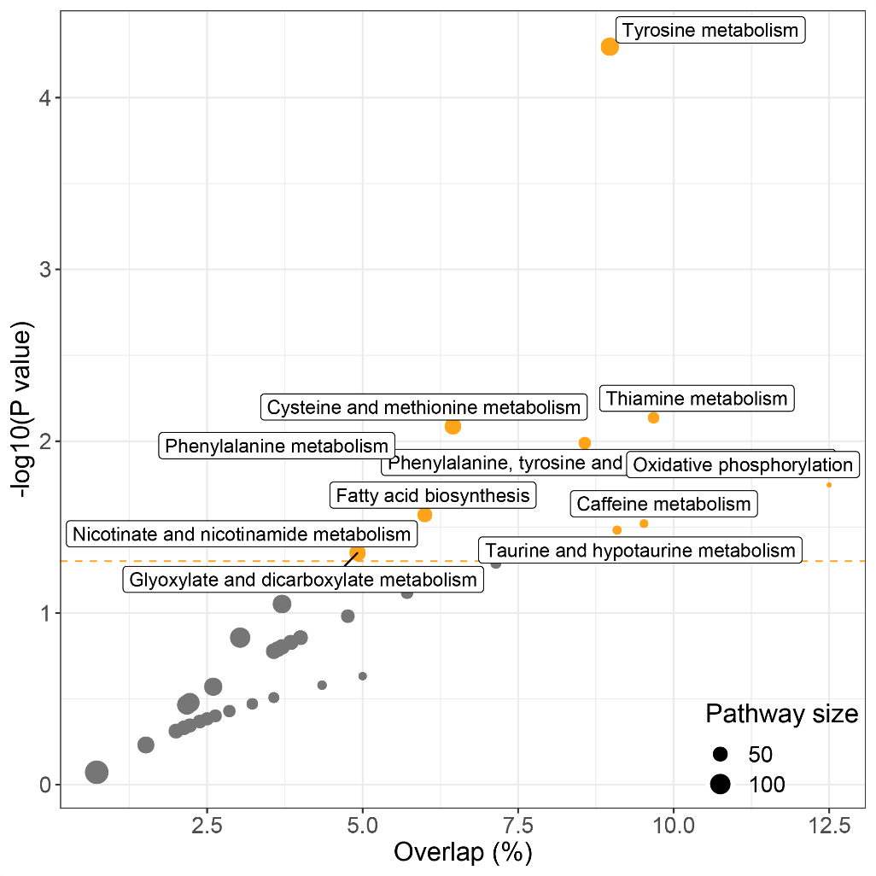
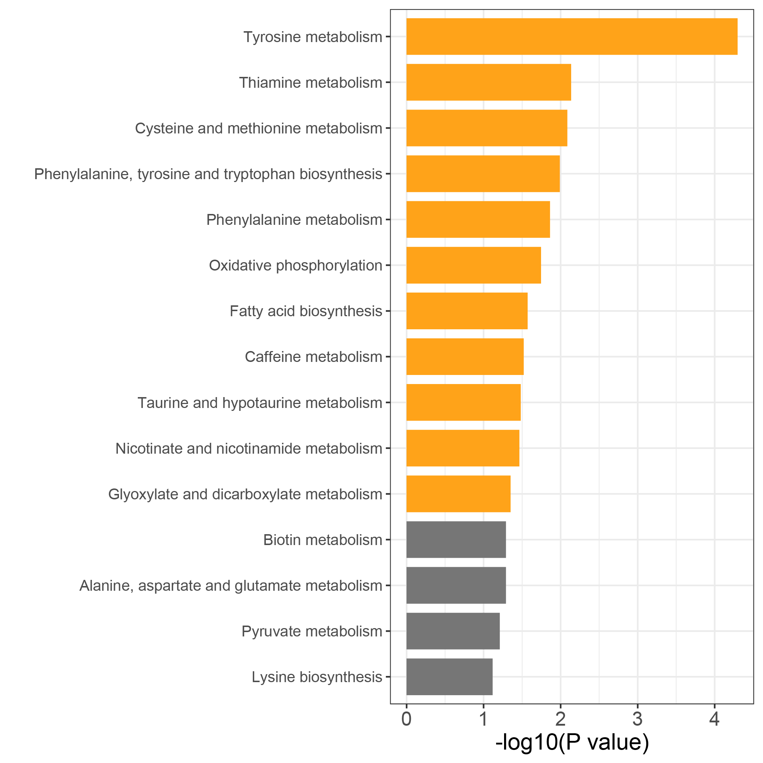
Functional analysis for cross-sectional subnetwork 5
57 our of 125 metabolites have KEGG ID.
Most of them are amino acid metabolism and lipid metabolism.

Slide 14
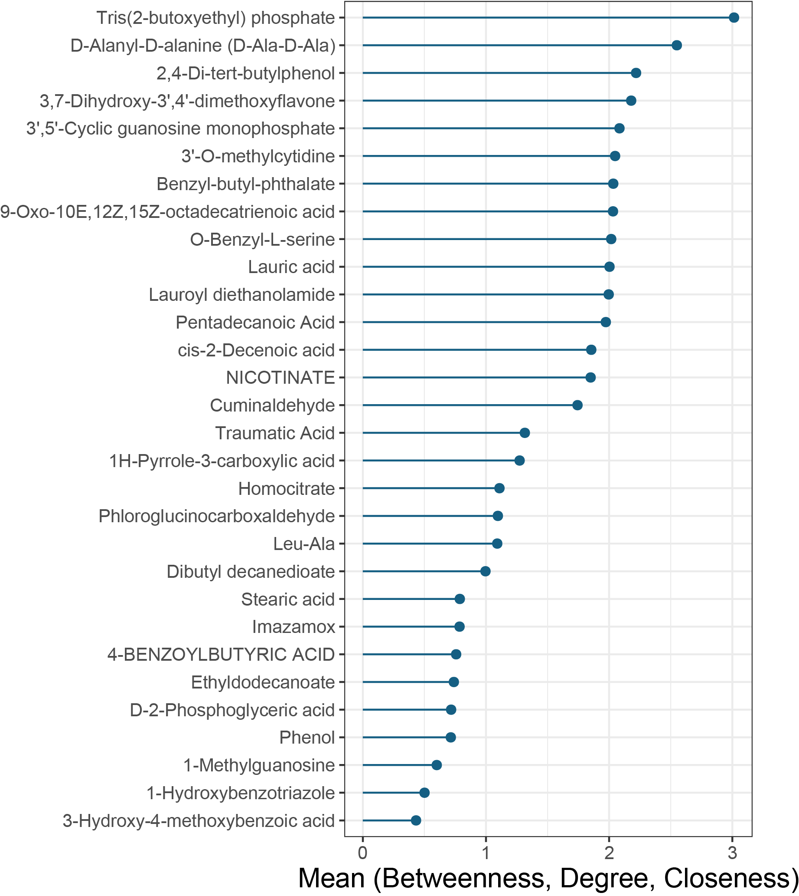
Functional analysis for cross-sectional subnetwork 5
Vertex Importance = mean(scaled betweenness, scaled closeness, scaled degree)
Importance

Slide 15
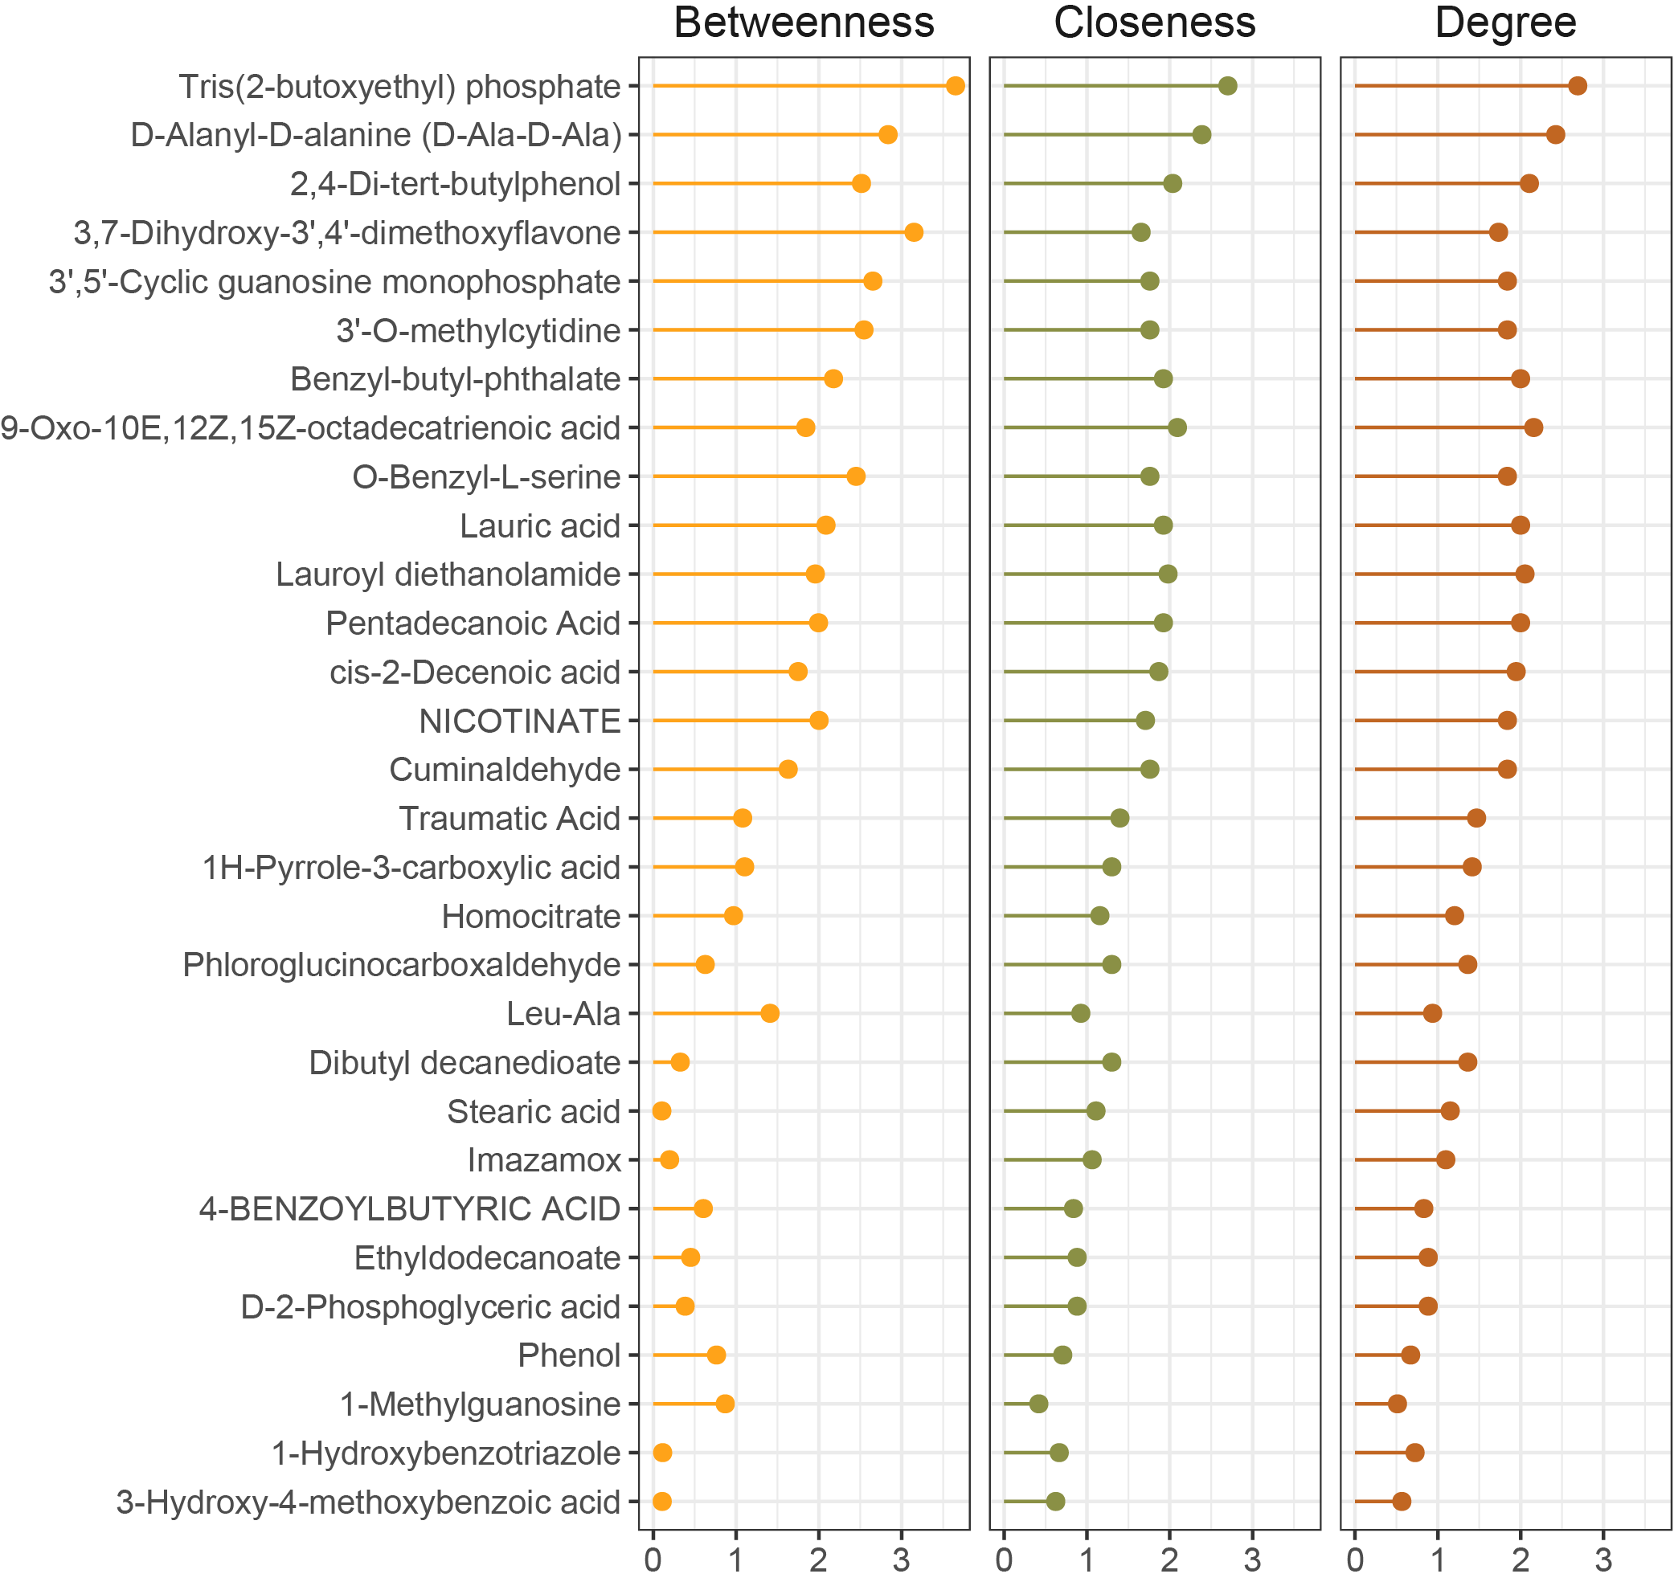
Functional analysis for cross-sectional subnetwork 5

Slide 16
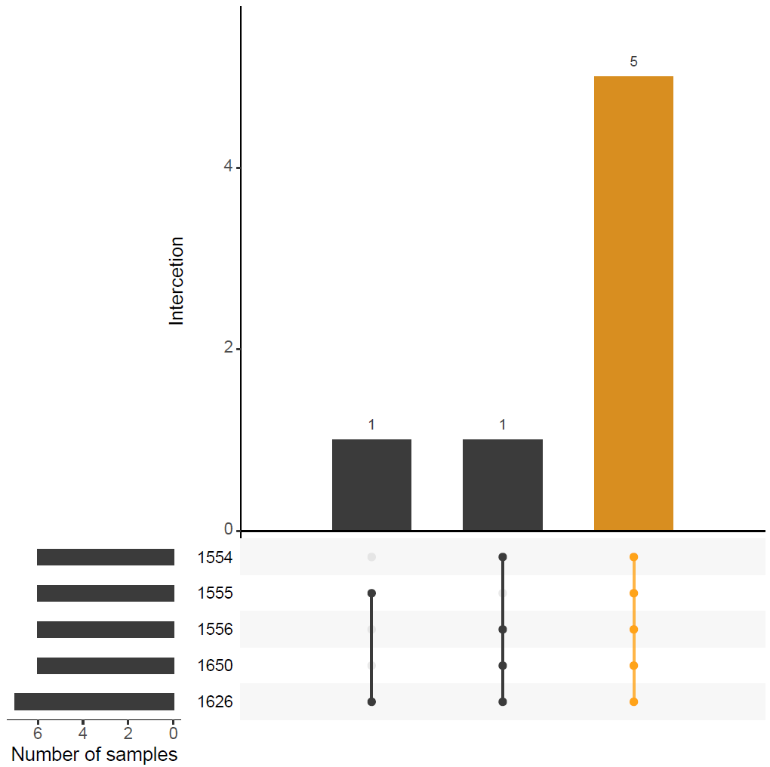
Delta correlation network
15-20, 20-25, 25-30, 30-35, 35-40

Slide 17
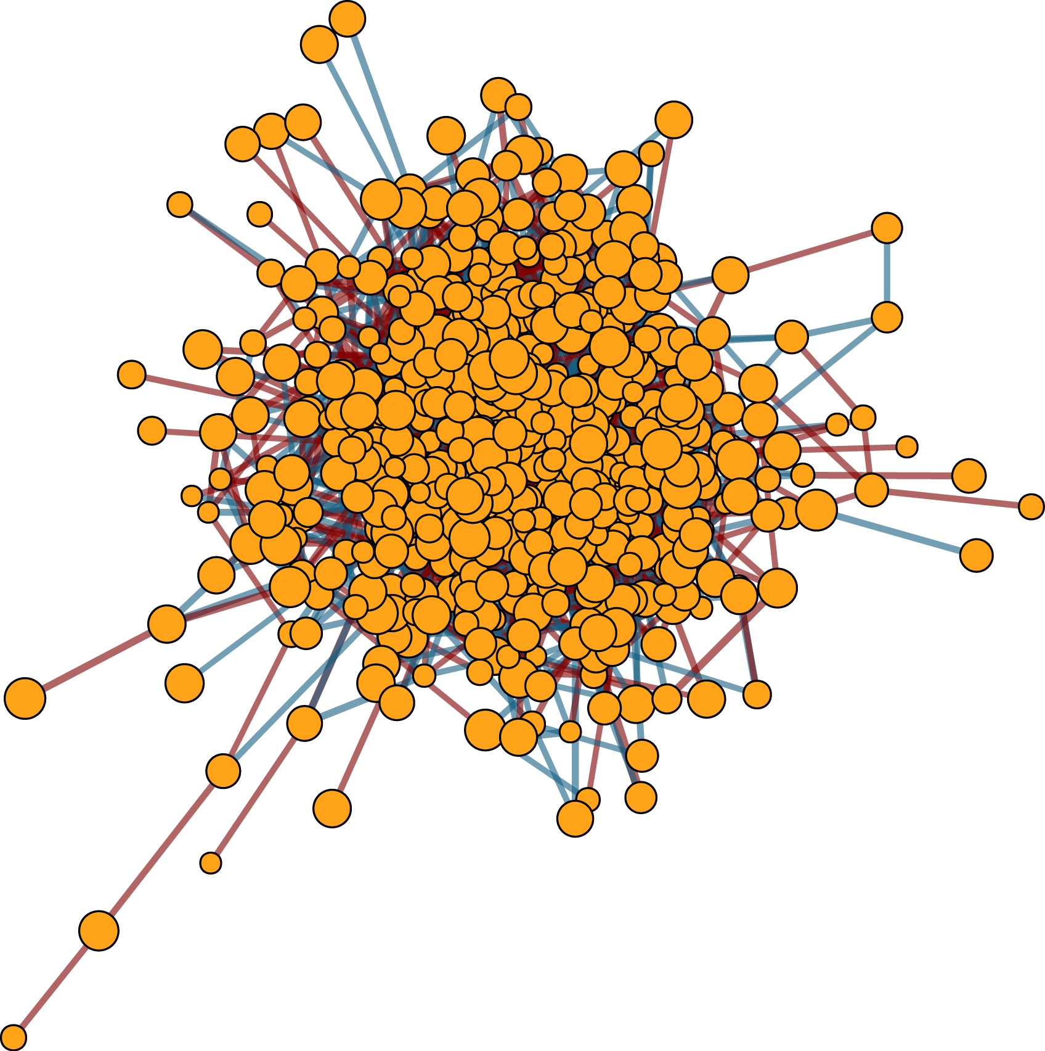
Whole delta correction network
515 vertexes (metabolites)
2,238 edges
Spearman correlation:
Correlation > 0.5 or Correlation < -0.5
P_{adjust} < 0.05

Slide 18
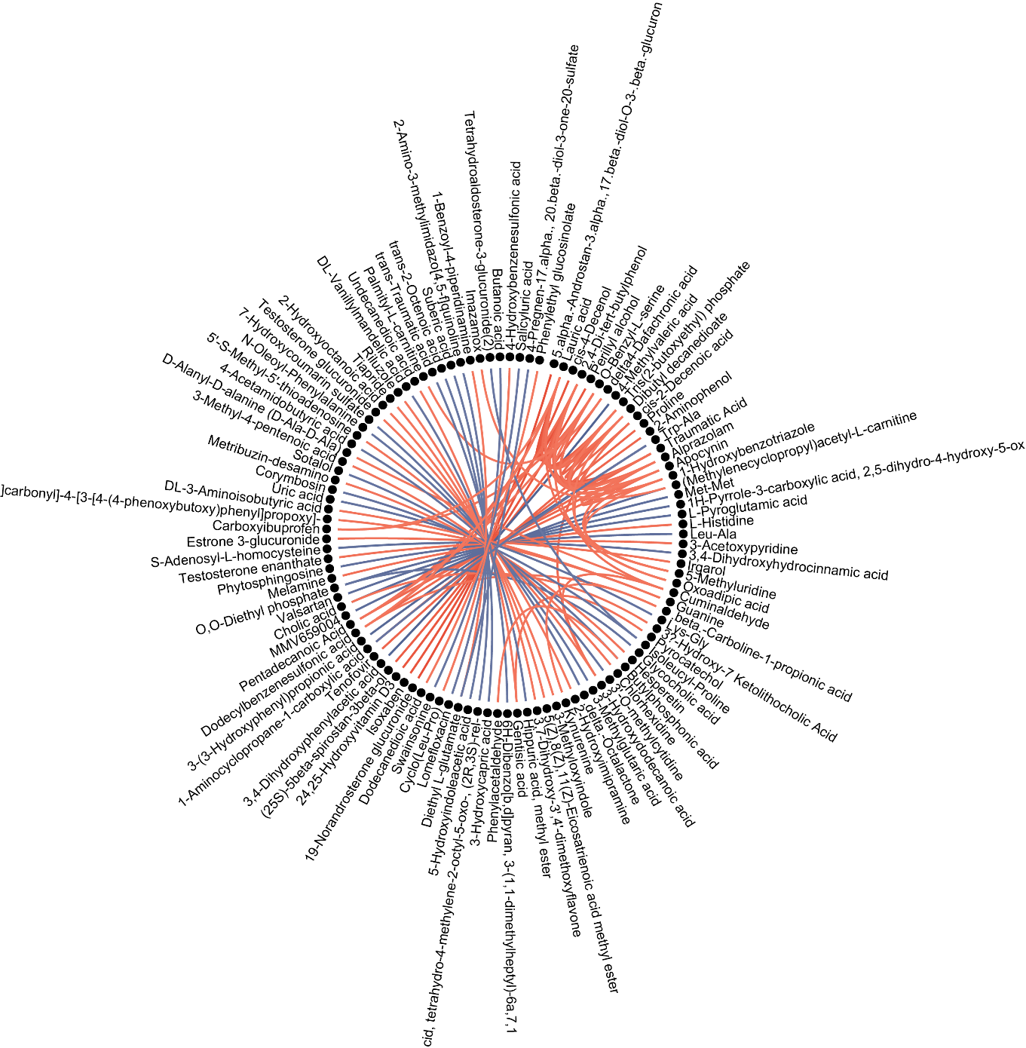
Top 100 correlations of delta correction network

Slide 19
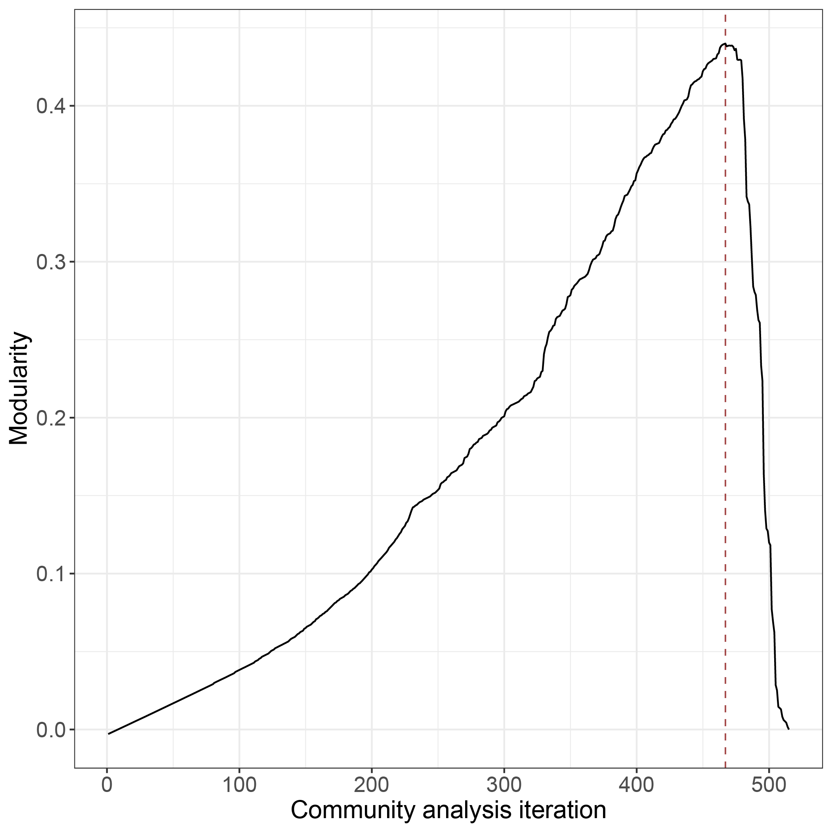
Subnetwork detection using community analysis
Modularity is 0.44 at 467 iteration
43 subnetworks with at least two vertexes (mean of 11.70 V and 27.42 E).
503 out of 515 vertexes (97.7%) are remained after community edge punching.
1,179 out of 2,238 edges (52.7%) are remained after community edge punching.

Slide 20
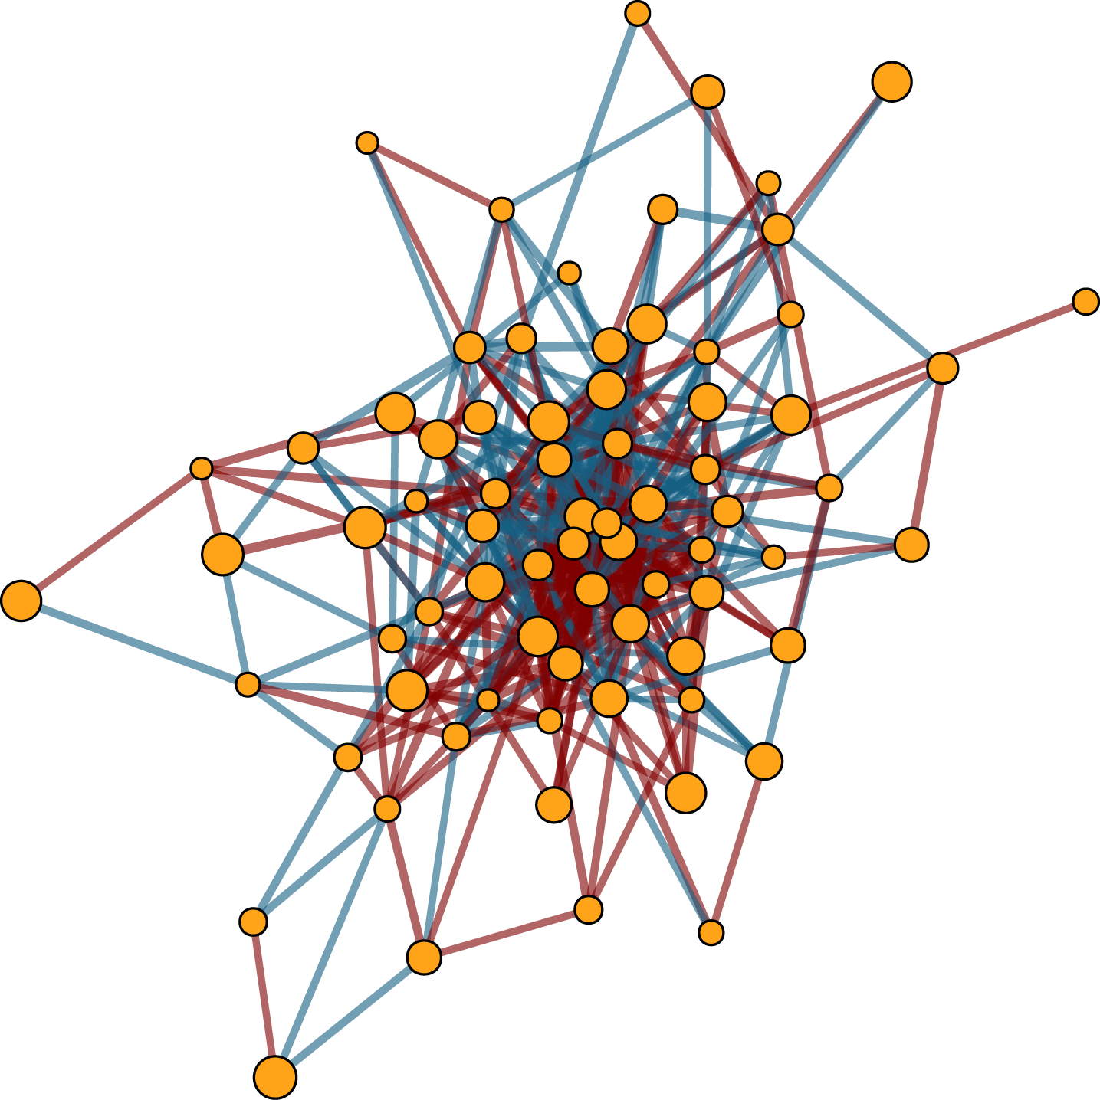
Delta subnetwork 3
74 vertexes (metabolites)
426 edges

Slide 21
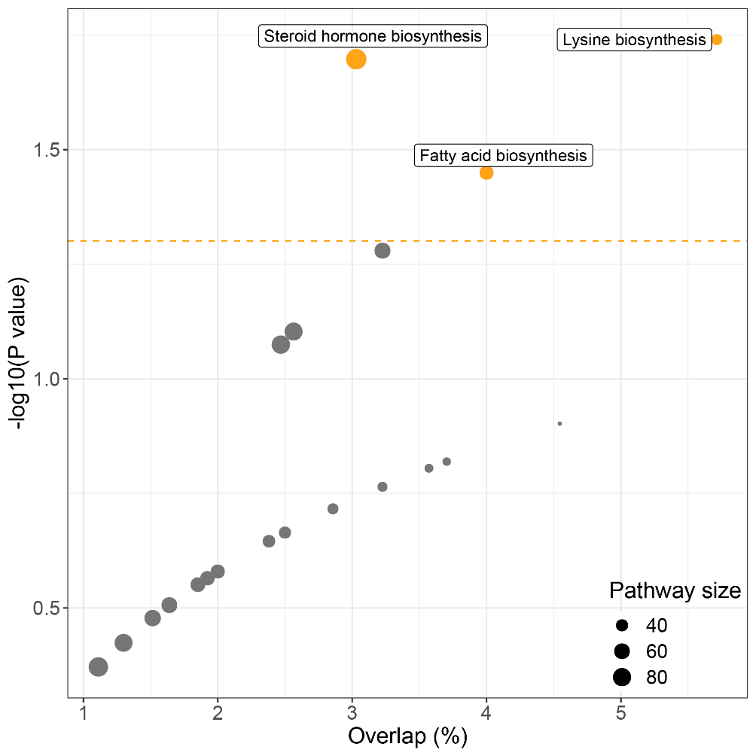
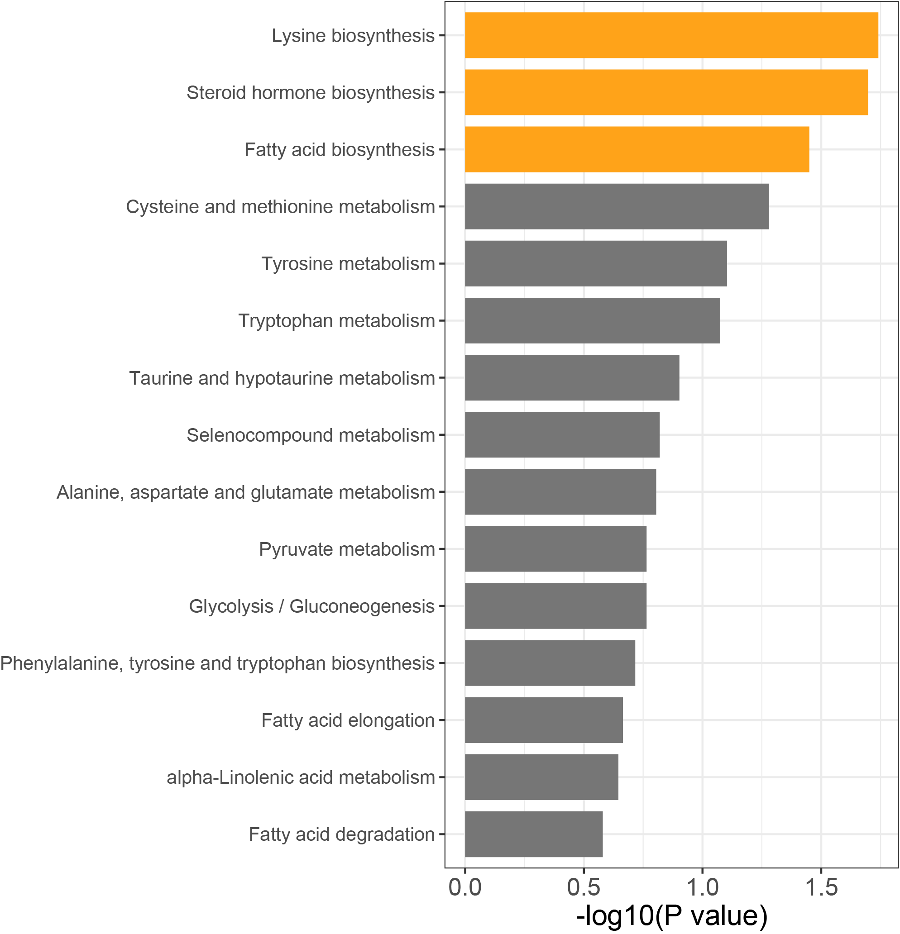
Functional analysis for delta subnetwork 3
33 our of 74 metabolites have KEGG ID.
All of them are amino acid metabolism and lipid metabolism.

Slide 22
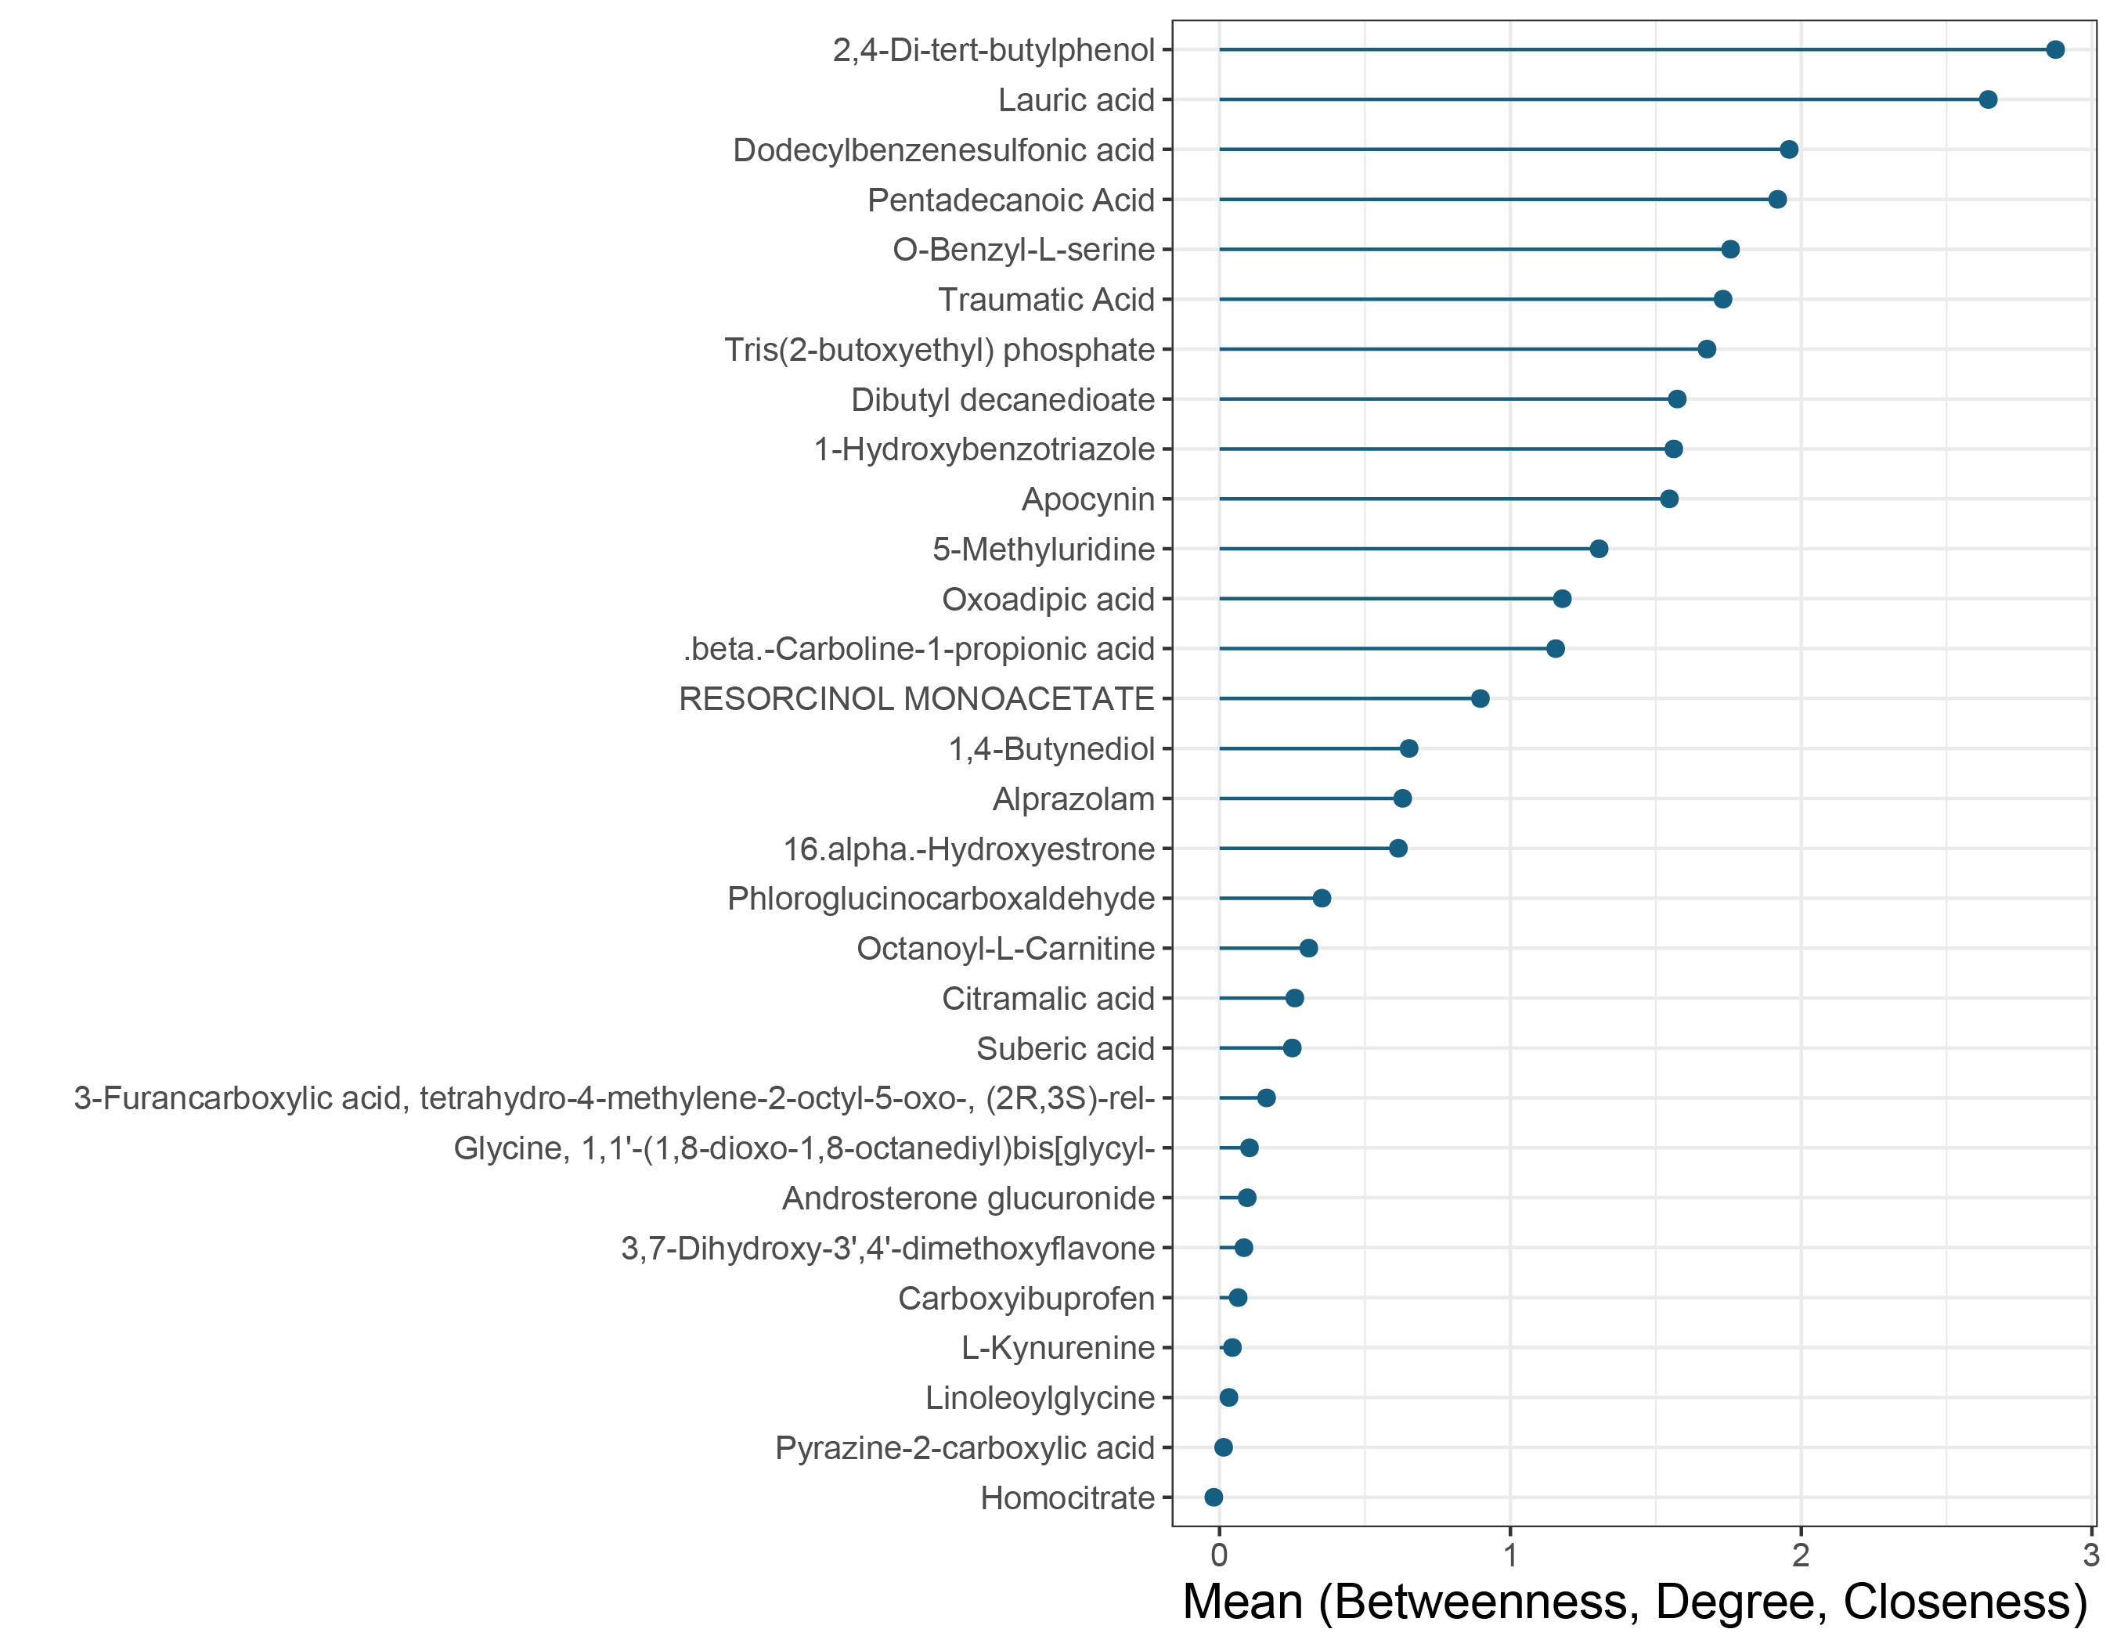
Functional analysis for delta subnetwork 3
Importance

Slide 23
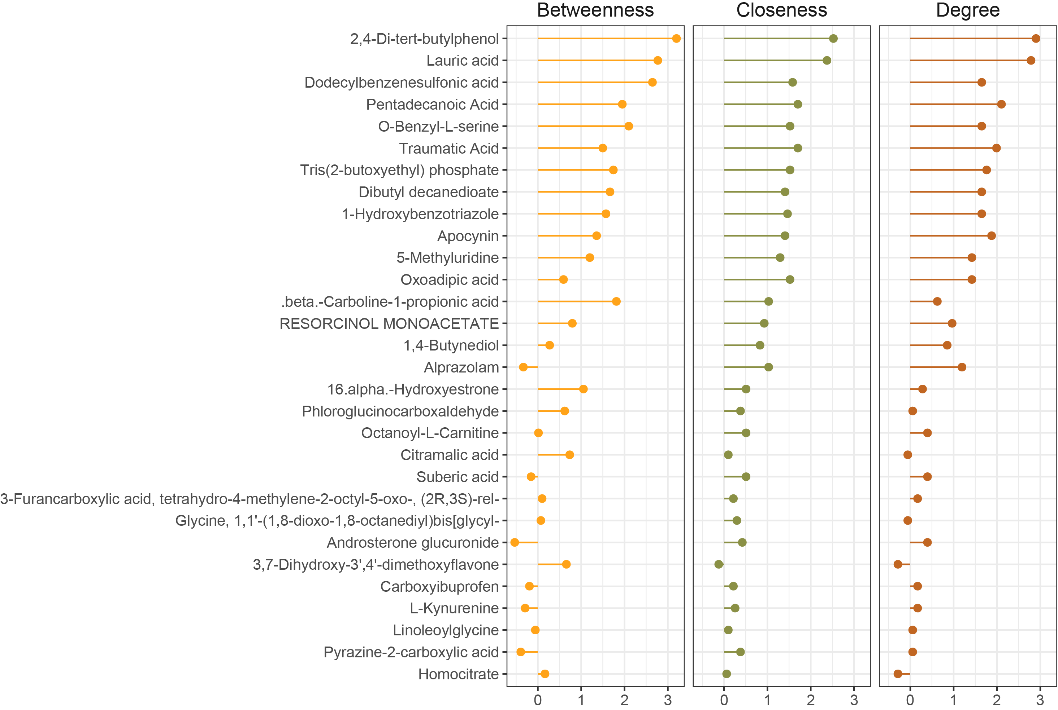
Functional analysis for delta subnetwork 3

Slide 24
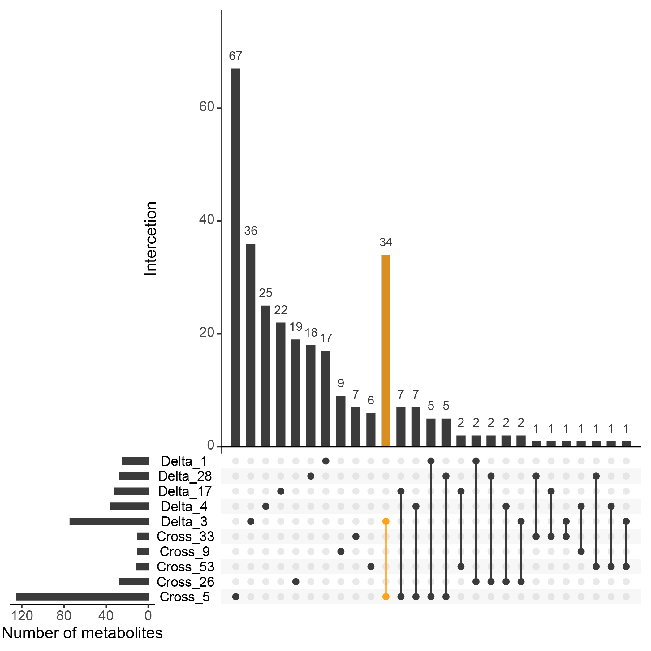
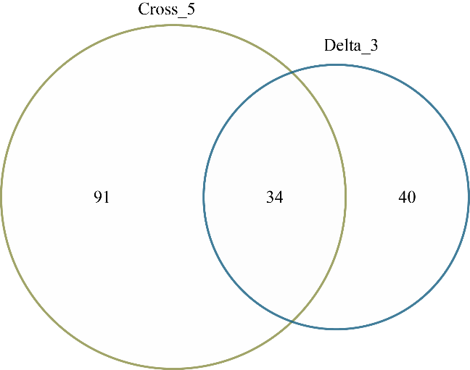
Overlap between subnetworks from two correlation networks

Slide 25
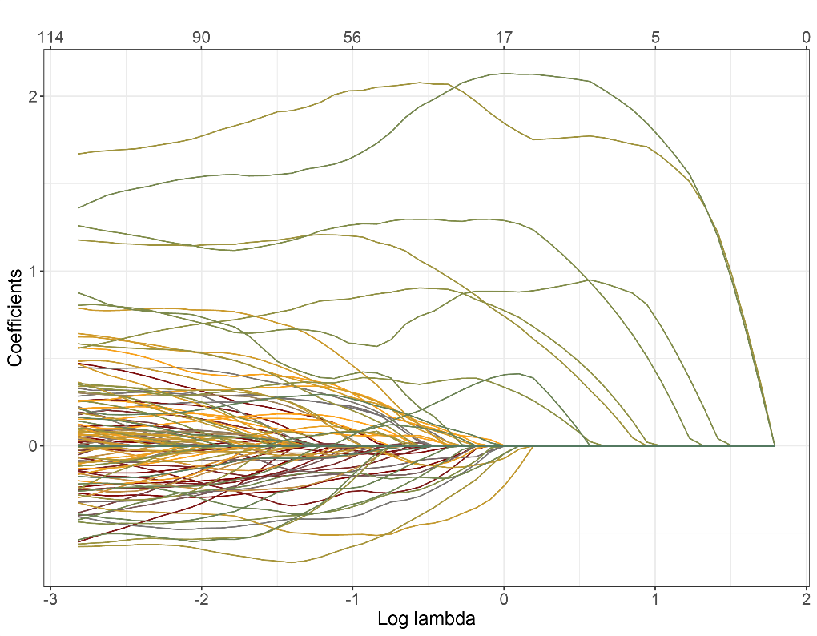
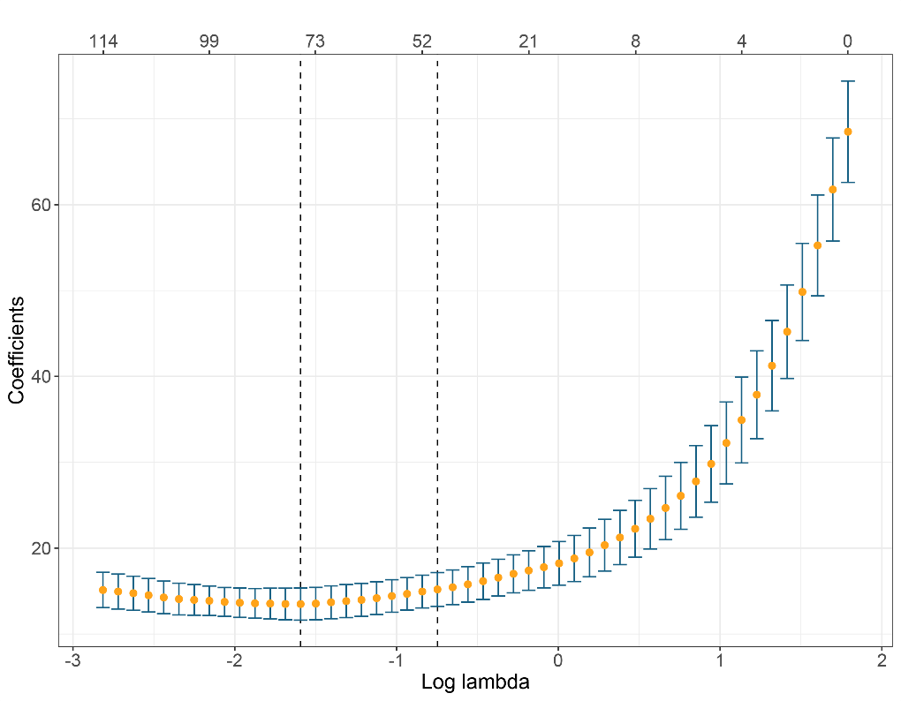
GA week prediction
Lasso regression

Slide 26
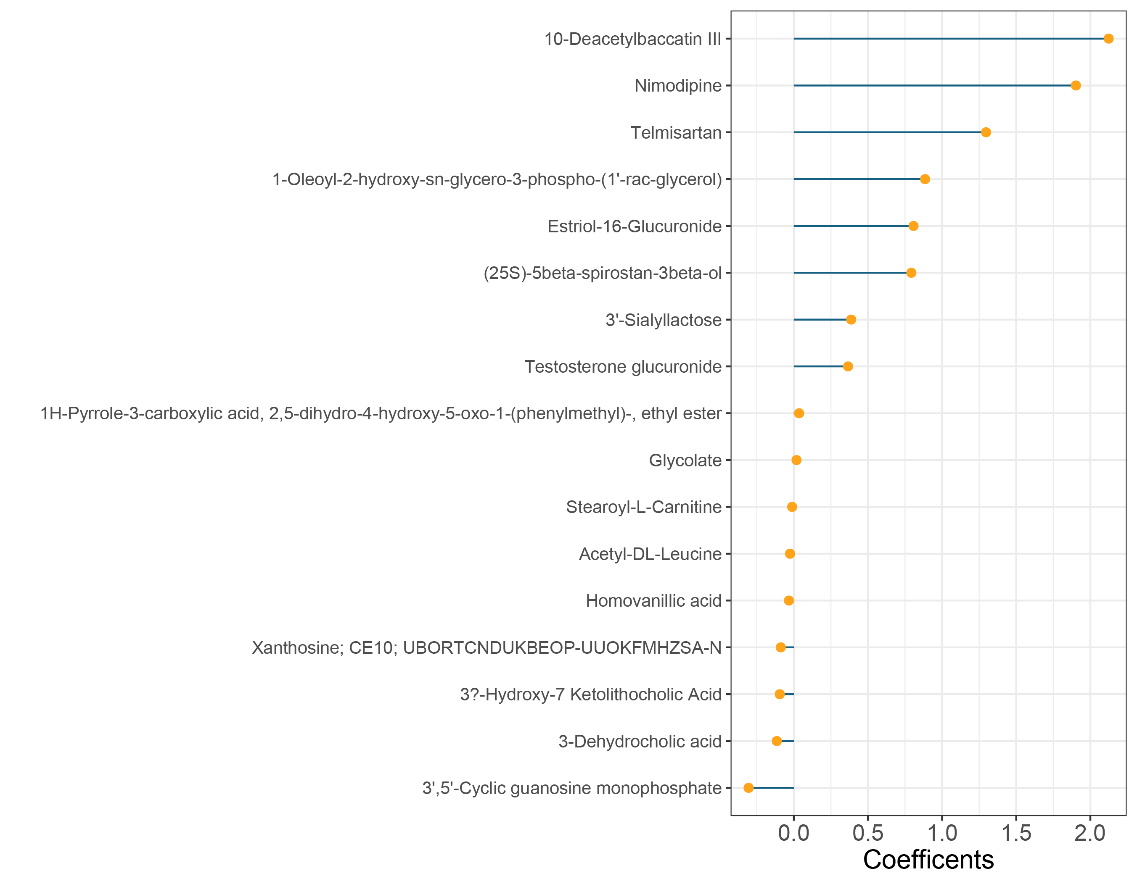
GA week prediction
Potential marker

Slide 27
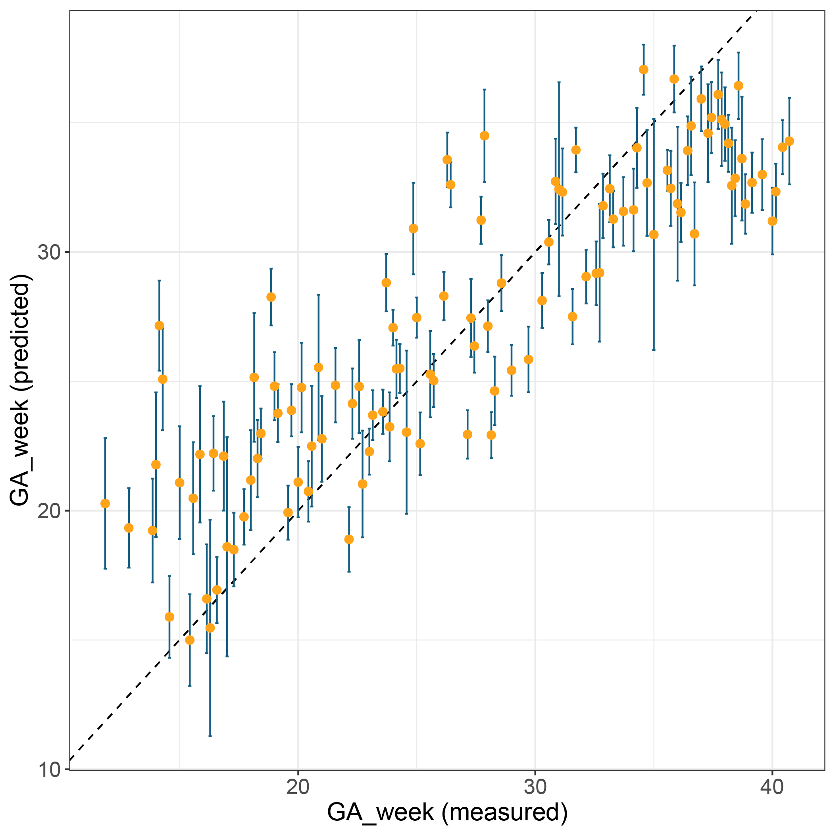
GA week prediction
Adjusted R2: 0.7621
ME: 3.43
P-value < 2.2*10⁻¹⁶

Slide 28
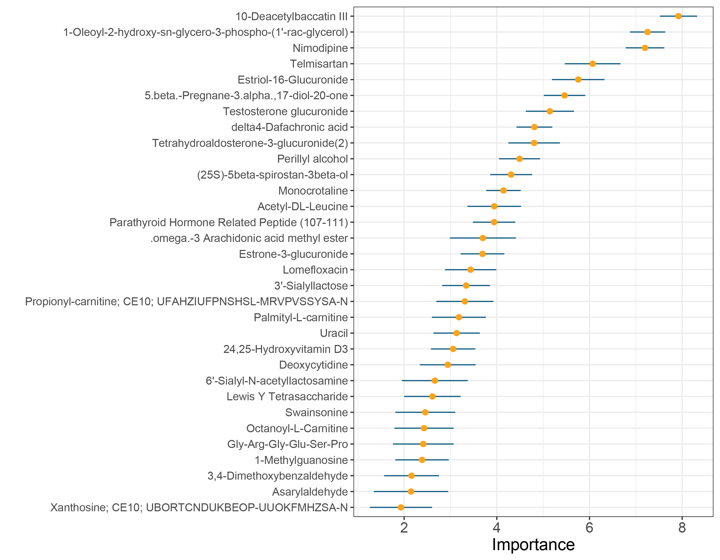
GA week prediction
Random Forest: Potential marker

Slide 29
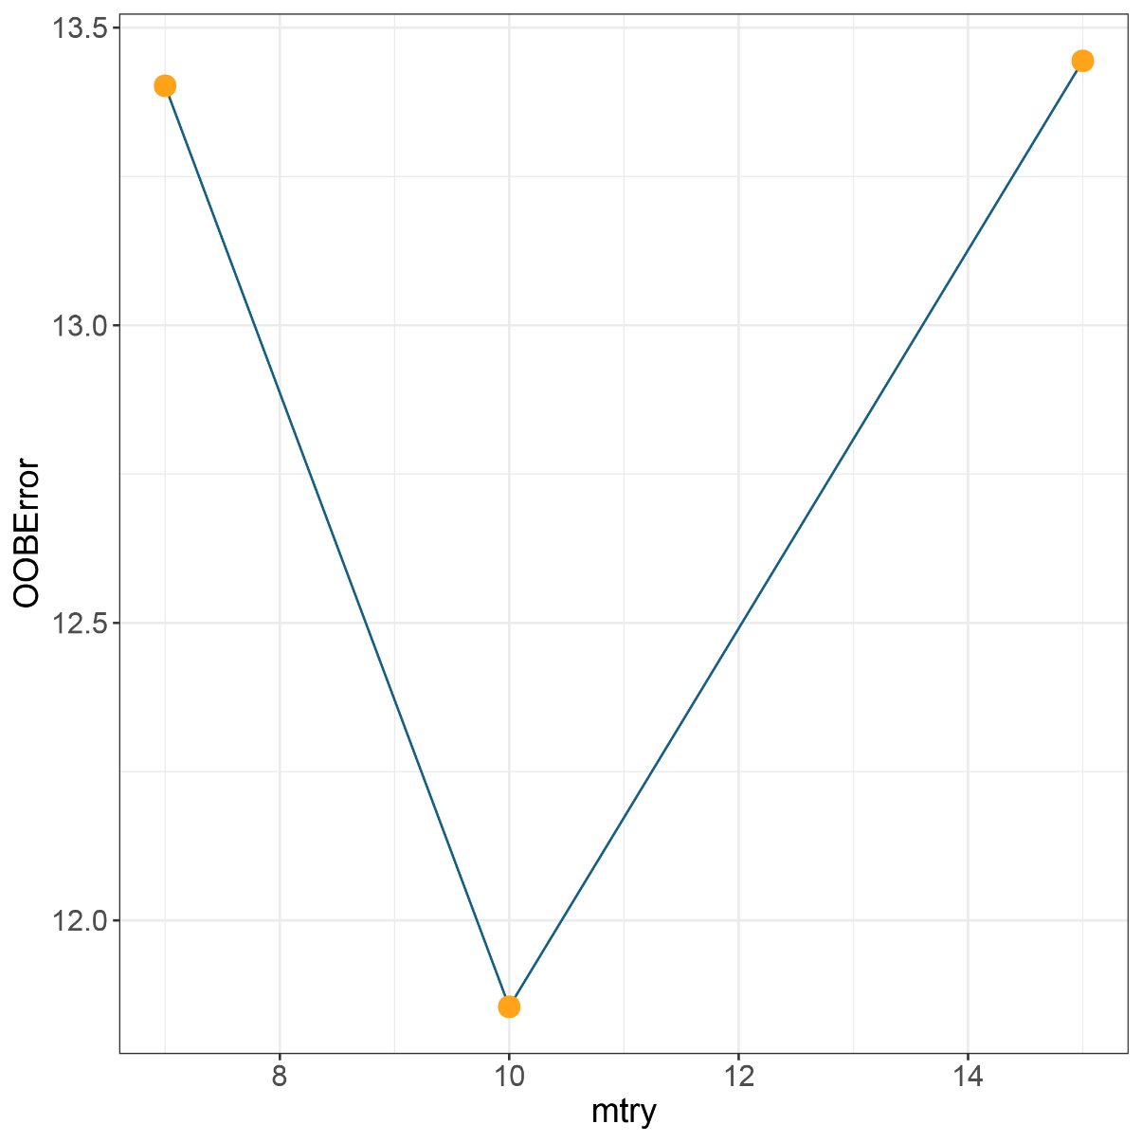
GA week prediction
Random Forest: Parameter tuning

Slide 30
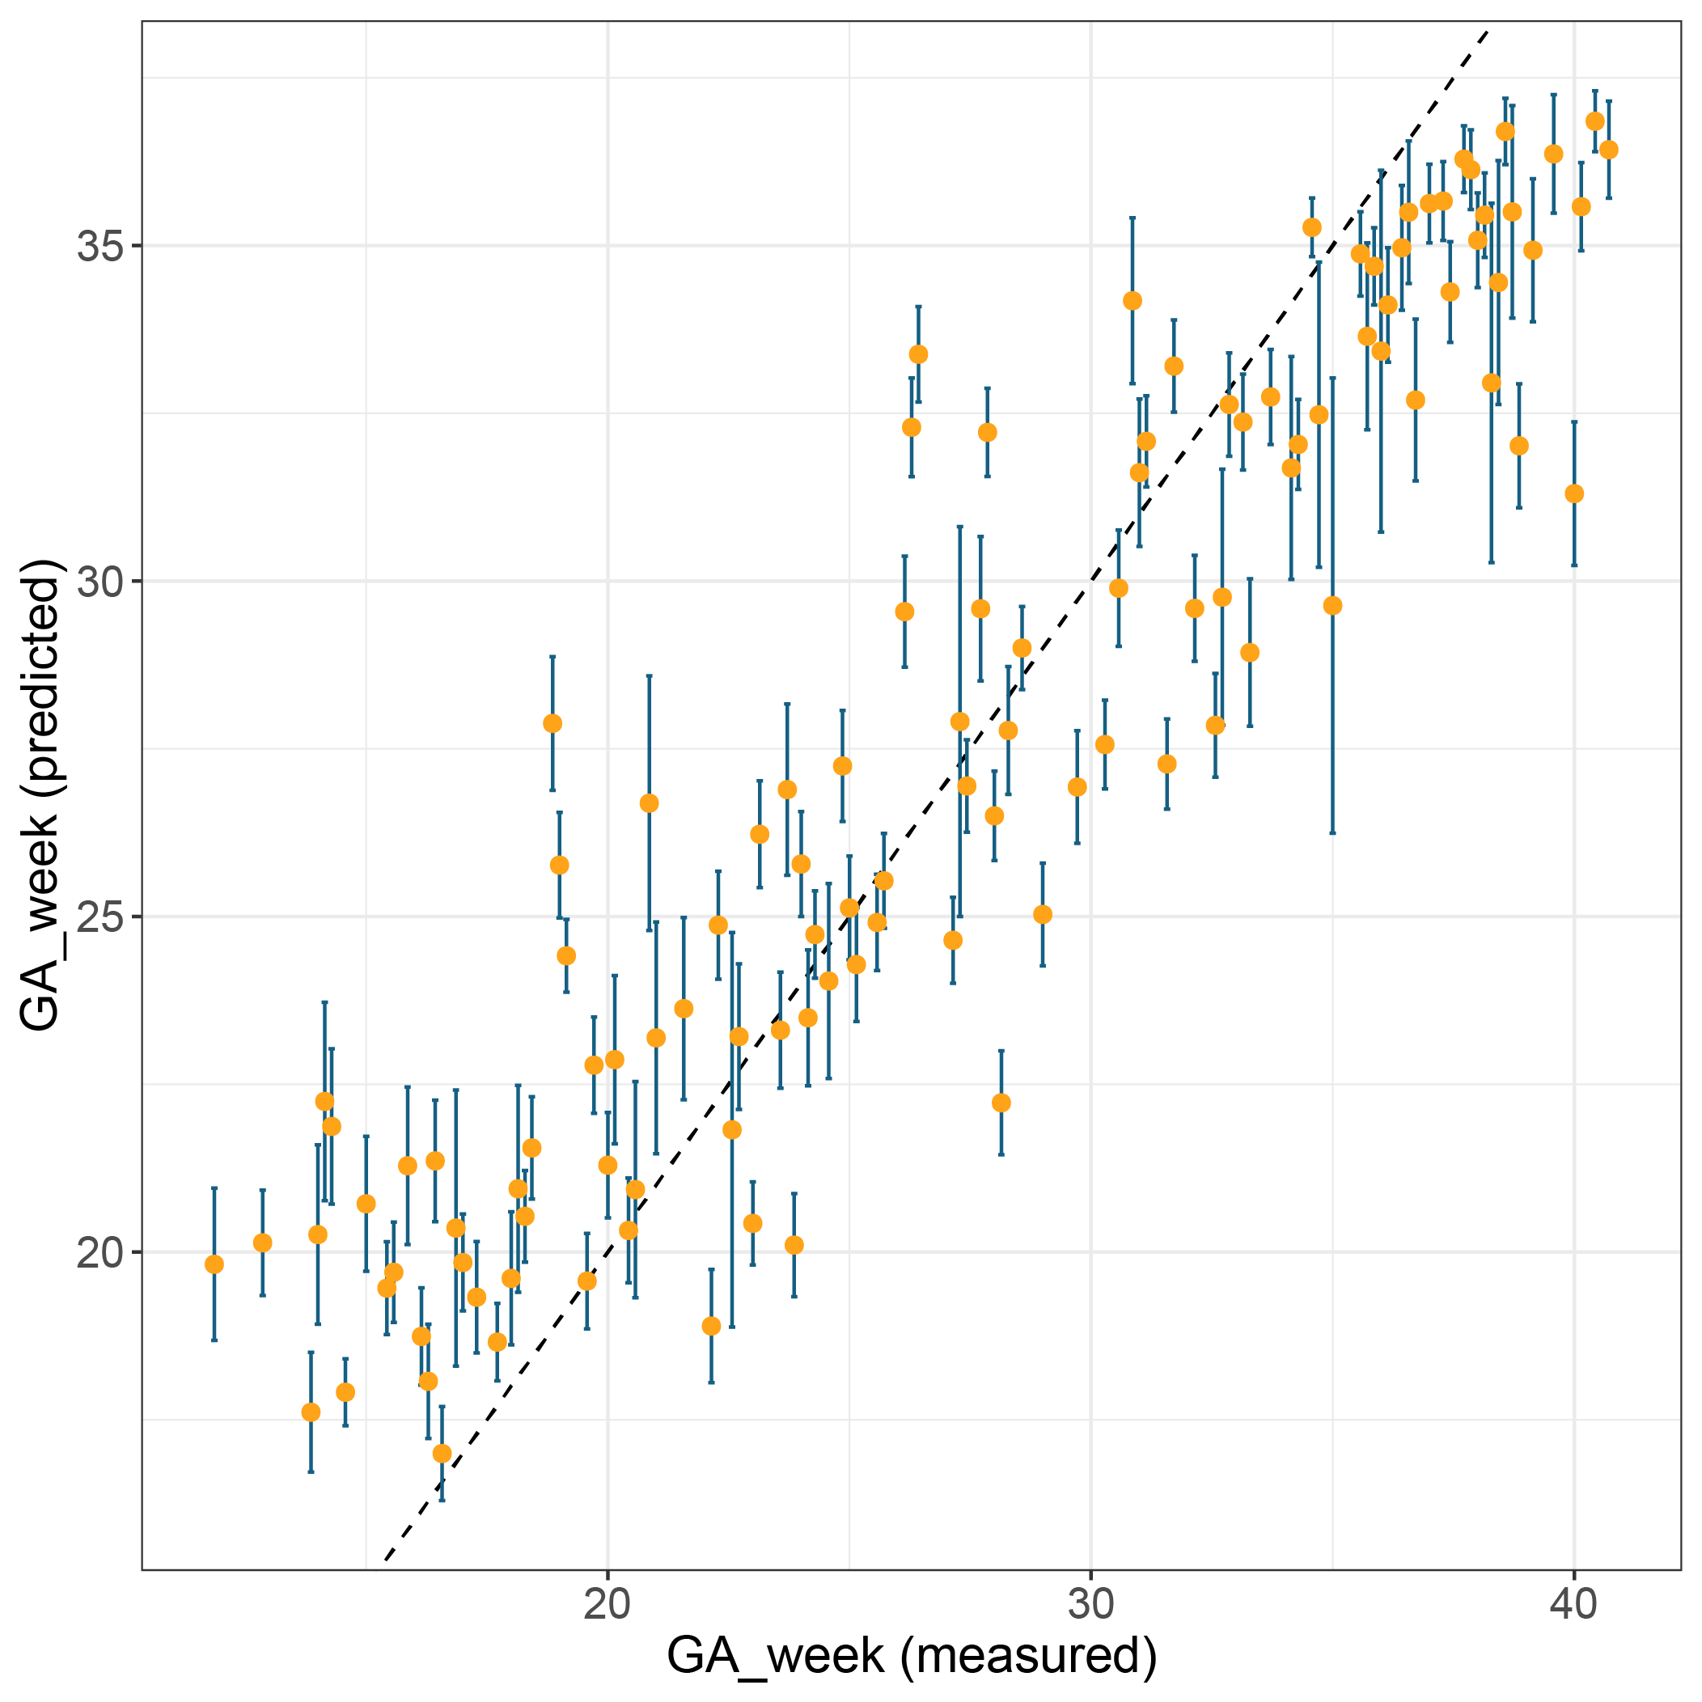
GA week prediction
Adjusted R2: 0.85
ME: 2.89
P-value < 2.2*10⁻¹⁶

Slide 31
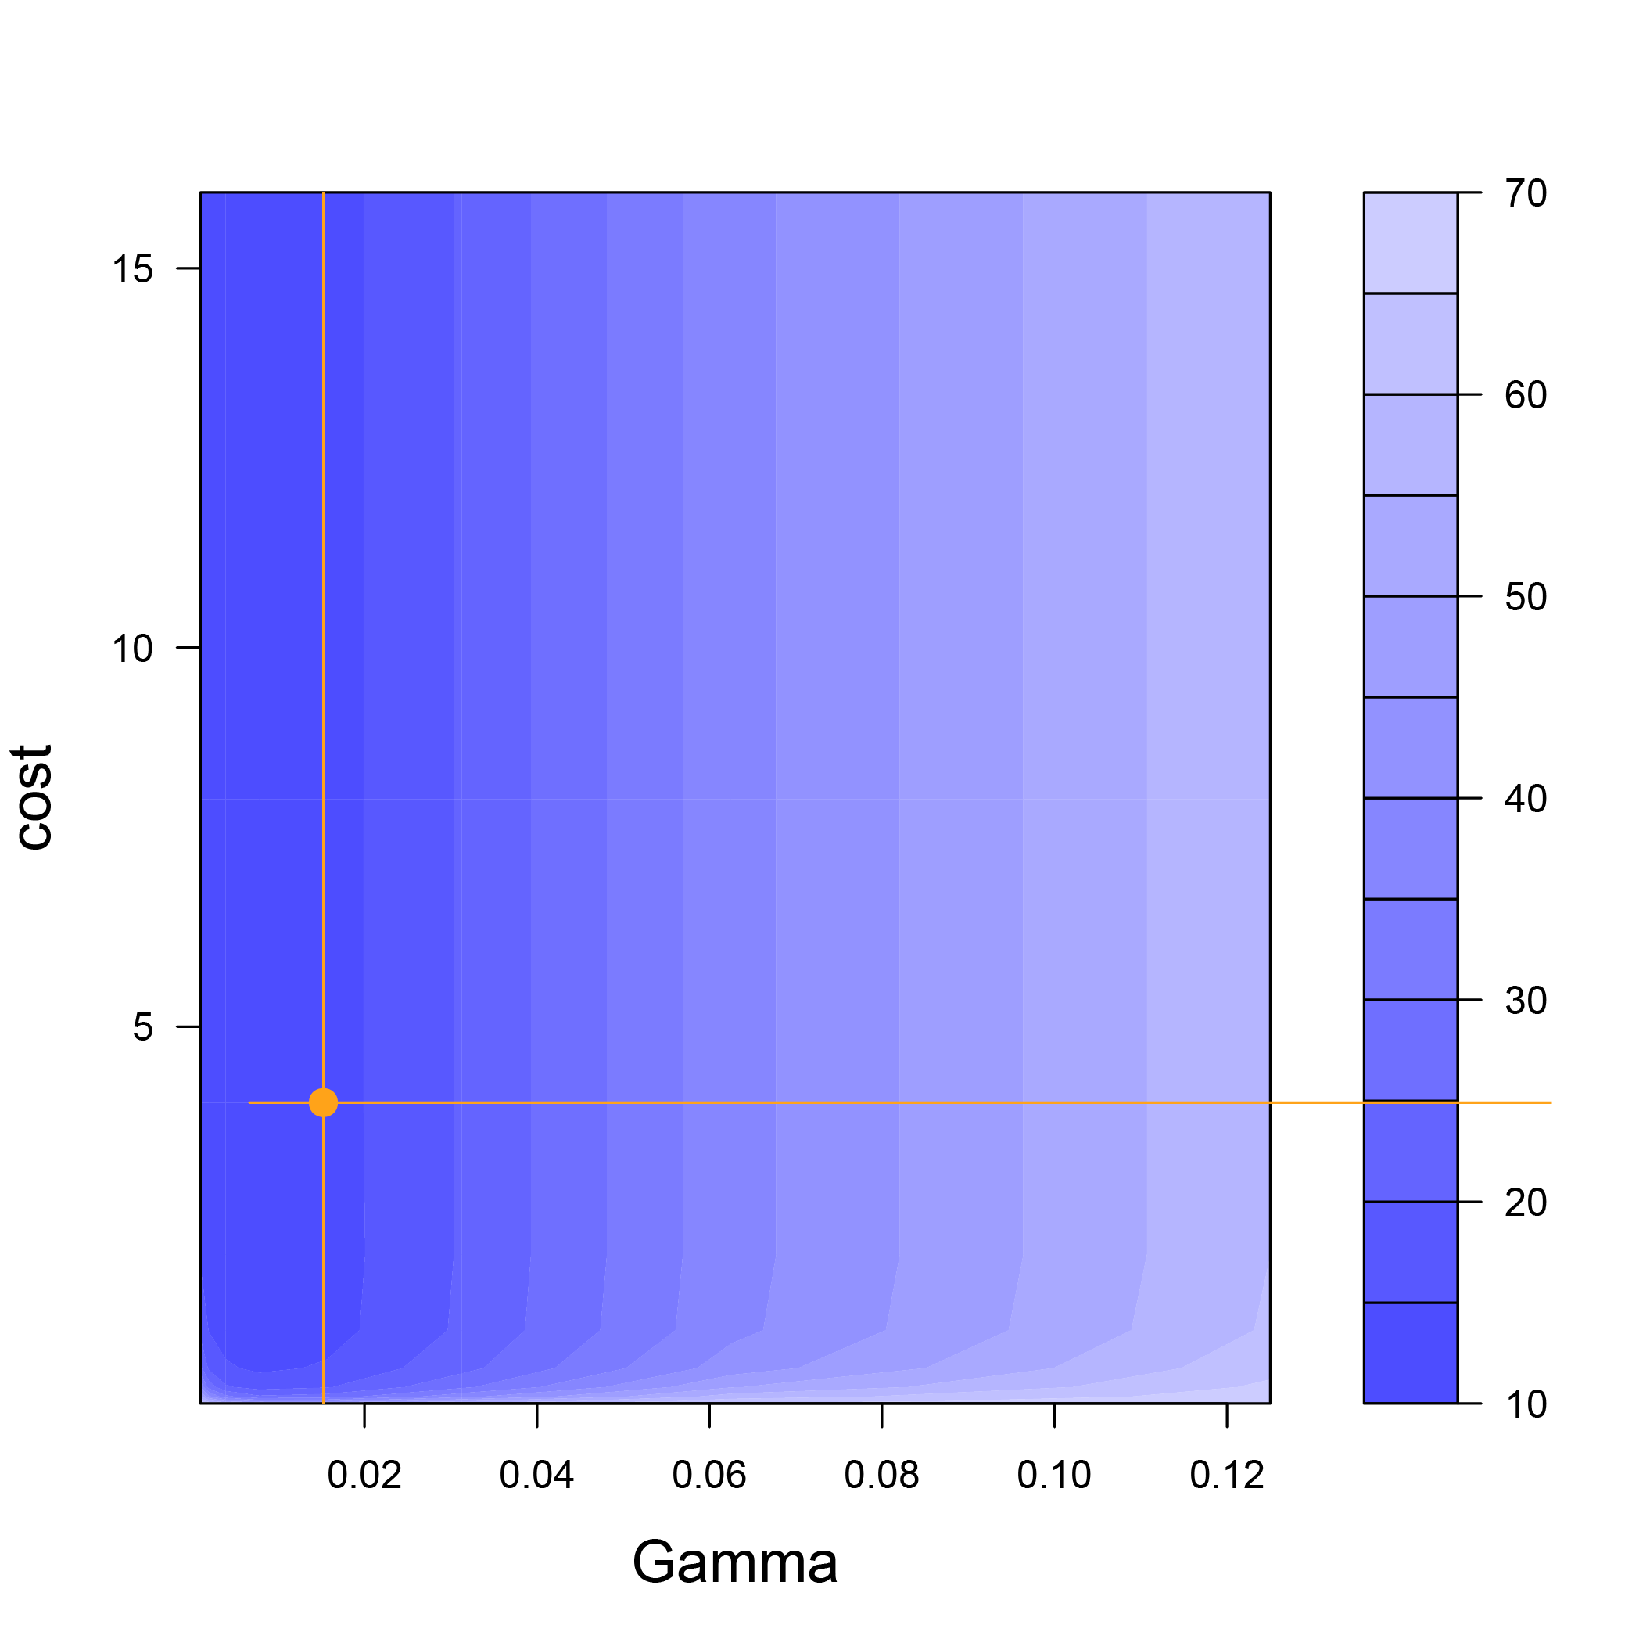
GA week prediction
Support Vector Machine (SVM): Parameter tuning

Slide 32
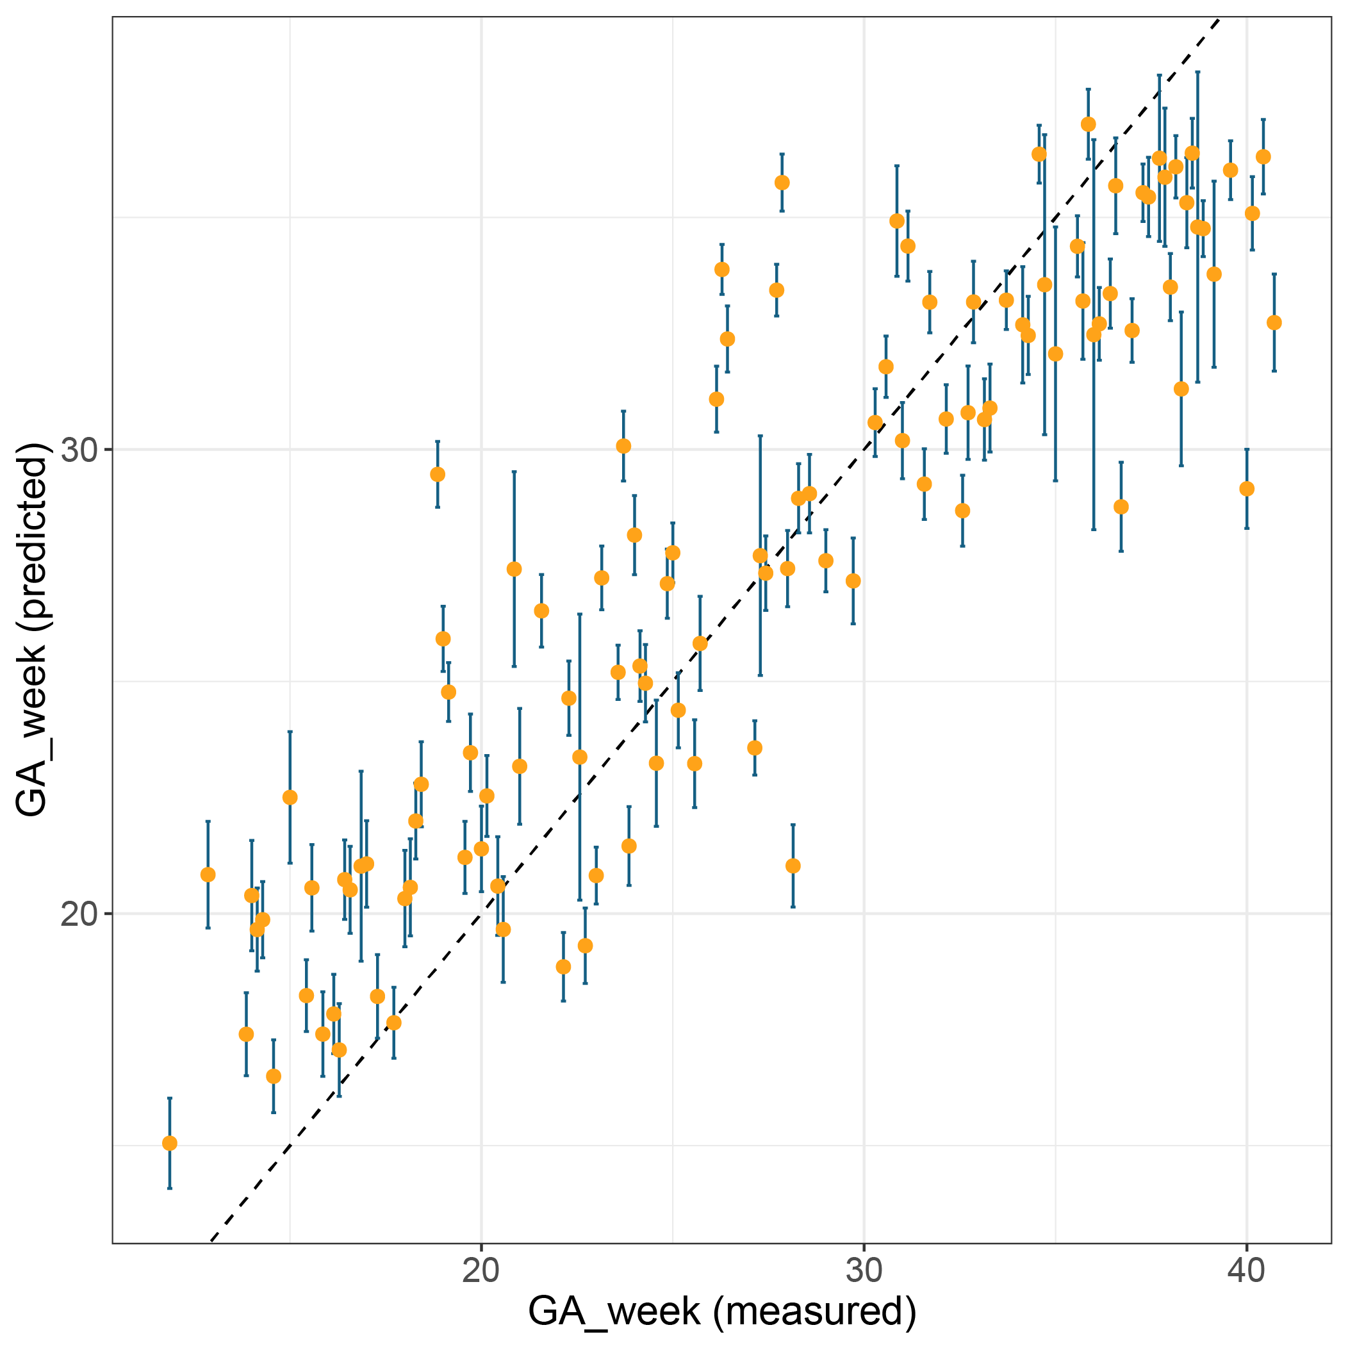
GA week prediction
Adjusted R2: 0.7941
ME: 3.27
P-value < 2.2*10⁻¹⁶

Slide 33
GA week prediction (Summary)
Model | RMSE | Adjusted R² | P-value
Lasso | 4.50 | 0.51 | < 2.2*10⁻¹⁶
Random Forest | 3.48 | 0.66 | < 2.2*10⁻¹⁶
Support Vector Machine |  |  | < 2.2*10⁻¹⁶
Artificial Neuronal Network |  |  | < 2.2*10⁻¹⁶
Model | RMSE | Adjusted R² | P-value
Lasso | 3.00 | 0.72 | < 2.2*10⁻¹⁶
Random Forest | 2.97 | 0.73 | < 2.2*10⁻¹⁶
Support Vector Machine |  |  | < 2.2*10⁻¹⁶
Artificial Neuronal Network |  |  | < 2.2*10⁻¹⁶
Urine has potential to predict pre-term of pregnancy.

Slide 34
Time to due date (Summary)
Model | RMSE | Adjusted R² | P-value
Lasso | 4.1 | 0.55 | < 2.2*10⁻¹⁶
Random Forest | 3.37 | 0.71 | < 2.2*10⁻¹⁶
Support Vector Machine |  |  | < 2.2*10⁻¹⁶
Artificial Neuronal Network |  |  | < 2.2*10⁻¹⁶
Model | RMSE | Adjusted R² | P-value
Lasso | 3.19 | 0.68 | < 2.2*10⁻¹⁶
Random Forest | 3.19 | 0.71 | < 2.2*10⁻¹⁶
Support Vector Machine |  |  | < 2.2*10⁻¹⁶
Artificial Neuronal Network |  |  | < 2.2*10⁻¹⁶
Urine has potential to predict pre-term of pregnancy.

Slide 35
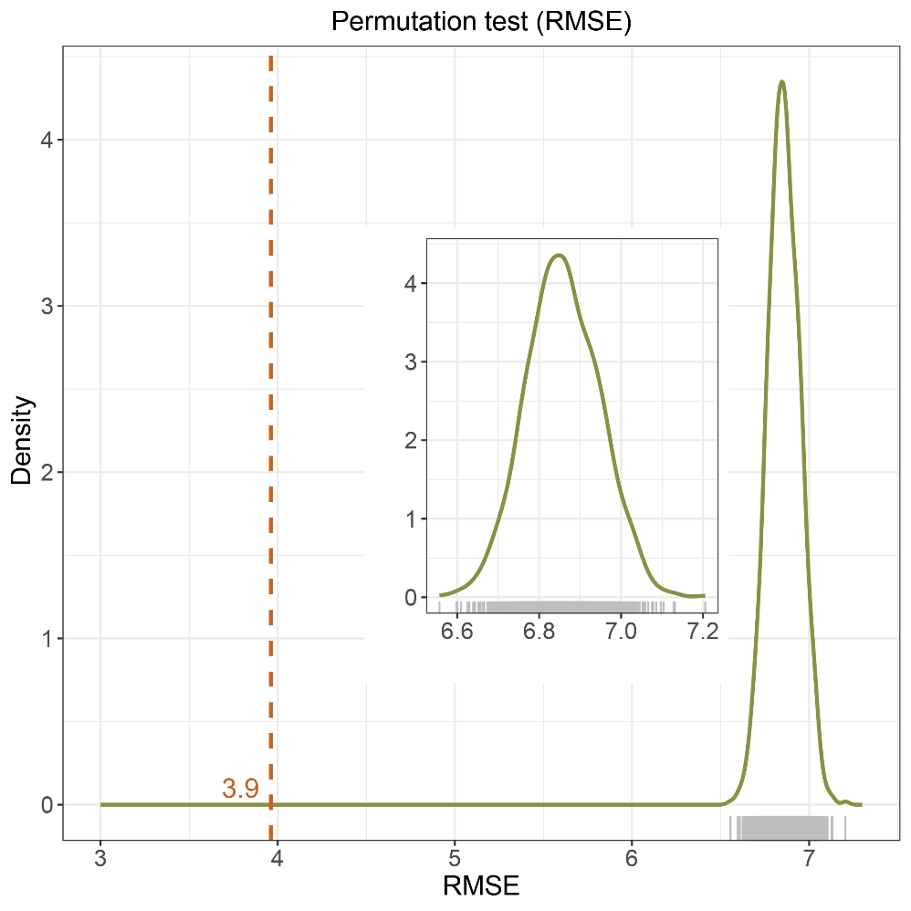
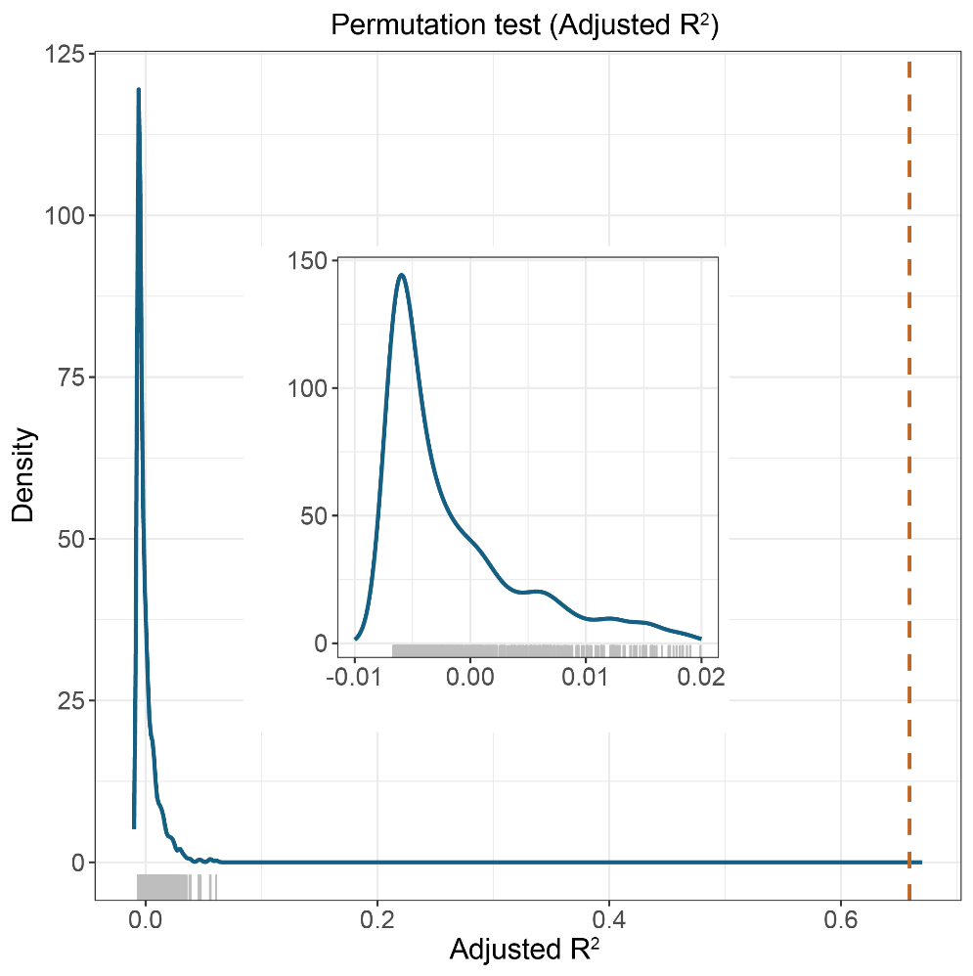
GA week prediction (Summary)
Urine has potential to predict pre-term of pregnancy.

